Slide 1
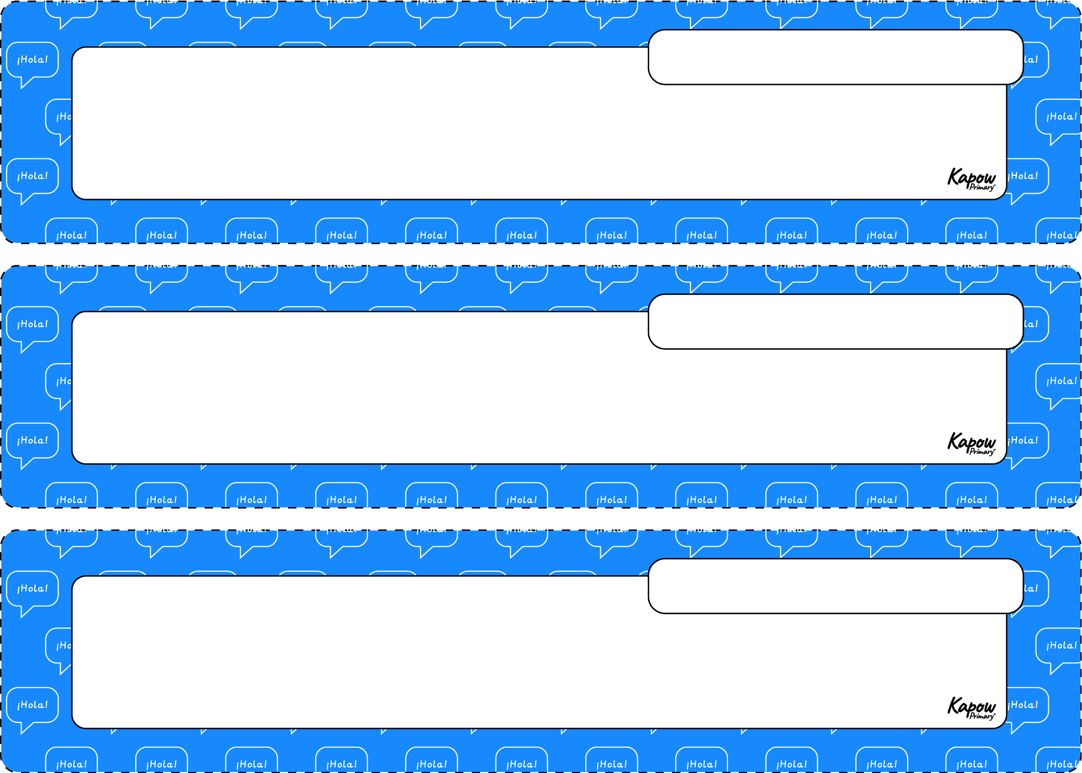
is
está
the northeast
el noreste
the southeast
el sureste

Slide 2
the northwest
el noroeste
the southwest
el suroeste
near
cerca de

Slide 3
also
también
to relax
descansar
to swim
nadar

Slide 4
to stroll
pasear
to go up
subir
to visit
visitar

Slide 5
WORD HERE
WORD HERE
WORD HERE
WORD HERE
WORD HERE
WORD HERE

Slide 6
WORD HERE
WORD HERE
WORD HERE
WORD HERE
WORD HERE
WORD HERE

