Slide 1
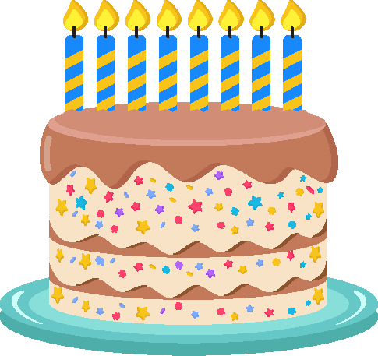
Knowledge catcher: Birthday celebrations
Answer the questions below in French.
1
Write in French how old you are. Write the number as a word.
_______________________________________________________________________
_______________________________________________________________________
2
Write a sentence to say when your birthday is in French.
For example: Mon anniversaire c’est le dix-huit avril.
_______________________________________________________________________
_______________________________________________________________________
a)
b)
c)
03/10
11/11
20/12
d)
e)
f)
15/06
13/03
30/05
3
Write the birthday dates shown above in French, e.g. le cinq mars.
The first number shown is the date, the second number is the month.
_______________________________________________________________________
_______________________________________________________________________
_______________________________________________________________________

