Slide 1
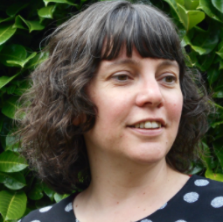
How to teach RSE & PSHE in mixed-age classes
by Sarah Huggins

Slide 2
What do you need to know about the
RSE & PSHE curriculum?

Slide 3
Long term planning
The components of the PSHE curriculum
Personal Social Health Economic (PSHE) education
Relationships
Health
Sex
Safety
Financial wellbeing
Personal skills

Slide 4
What does the statutory Relationships Education include?
Families and people who care for me
Importance of, characteristics, different families, stable and caring relationships, marriage and problems in families.
Caring friendships
Importance of, characteristics, healthy friendships, ups and downs and trust.
Respectful relationships
Courtesy and manners, self-respect, respect of others, bullying, stereotypes and permission seeking.
Online relationships
Behaviour online, respect, rules of keeping safe, critically consider online friendships and use of information.
Being safe
Boundaries, privacy, physical contact, appropriate and safe responses to adults, recognising and reporting feelings, asking for advice, reporting concerns and where to get advice.

Slide 5
What does statutory Health Education include?
Mental wellbeing Part of daily life, range of emotions, recognise and talk about emotions, appropriate and proportionate behaviour, activities to support, self care, impact of isolation, bullying, seeking support and mental ill health.
Internet safety and harms Benefits, time online, effect of actions, age restrictions, negatives of internet, discerning consumer and reporting concerns.
Physical health and fitness Benefits of activity, regular exercise, risks of inactivity and seeking support.
Basic first aid Call emergency services and dealing with common injuries.
Healthy eating Healthy diet, healthy meals, poor diet and associated risks.
Drugs, alcohol and tobacco Facts about legal and illegal harmful substances, risks, smoking, alcohol and drug taking.
Health and prevention Early signs of illness, exposure to the sun, importance of sleep, dental health, personal hygiene, allergies and vaccination. Changing adolescent body Puberty, physical and emotional changes, menstrual wellbeing.

Slide 6
Should Primary schools teach sex education?
Science National Curriculum includes some aspects although human reproduction is optional.
DfE recommends children know “how a baby is conceived and born” before leaving primary school.
Parents have the right to withdraw their children from Sex Education beyond the Science National Curriculum.
Right to withdraw should be in your policy.

Slide 7
What are the challenges faced by classroom teachers?
Lacking confidence in their own RSE and PSHSE knowledge.
Worrying about teaching issues which could be sensitive and where difficult questions could arise.
Lacking the time to plan and resource.
Struggling to ‘pitch’ the lesson at the correct level for the age range they teach and for those pupils who need further support or extension.
Ensuring that lessons build on previous years’ learning.
Assessing children’s progress.
Ensuring there is no duplication of lessons or gaps in learning.

Slide 8
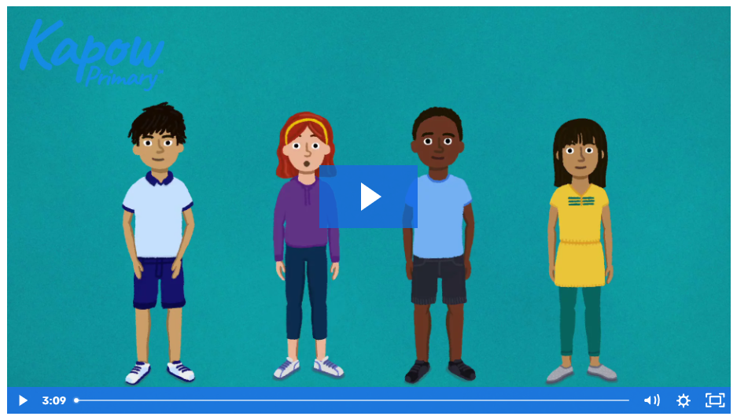
How Kapow Primary can help
Full scheme of work for mixed-age classes delivering the statutory requirements of the RSE curriculum as well as PSHE.
Authored by RSE & PSHSE specialist teachers.
Six bespoke, animated pupil videos covering puberty and sex education.
Collection of teacher support videos covering key curriculum areas.
Planning assessments and knowledge organisers, including 3 I’s statement outlining the intent and rationale behind the scheme.

Slide 9
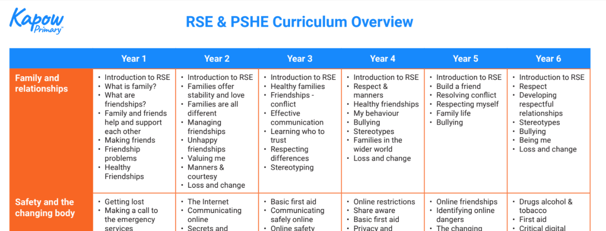
Kapow Primary’s Curriculum overview
Our Curriculum overview shows how Kapow Primary’s scheme covers the statutory content for Relationships and Health education.
We also show how our lessons link to the PSHE Association Programme of Study.

Slide 10
RSE & PSHE units
Each year group covers the following topics as part of a spiral curriculum:
Family and relationships
Health and wellbeing
Safety and the changing body
Citizenship
Economic wellbeing
As well as an introductory lesson and transition lesson.
Year 6 has an additional unit on identity.

Slide 11
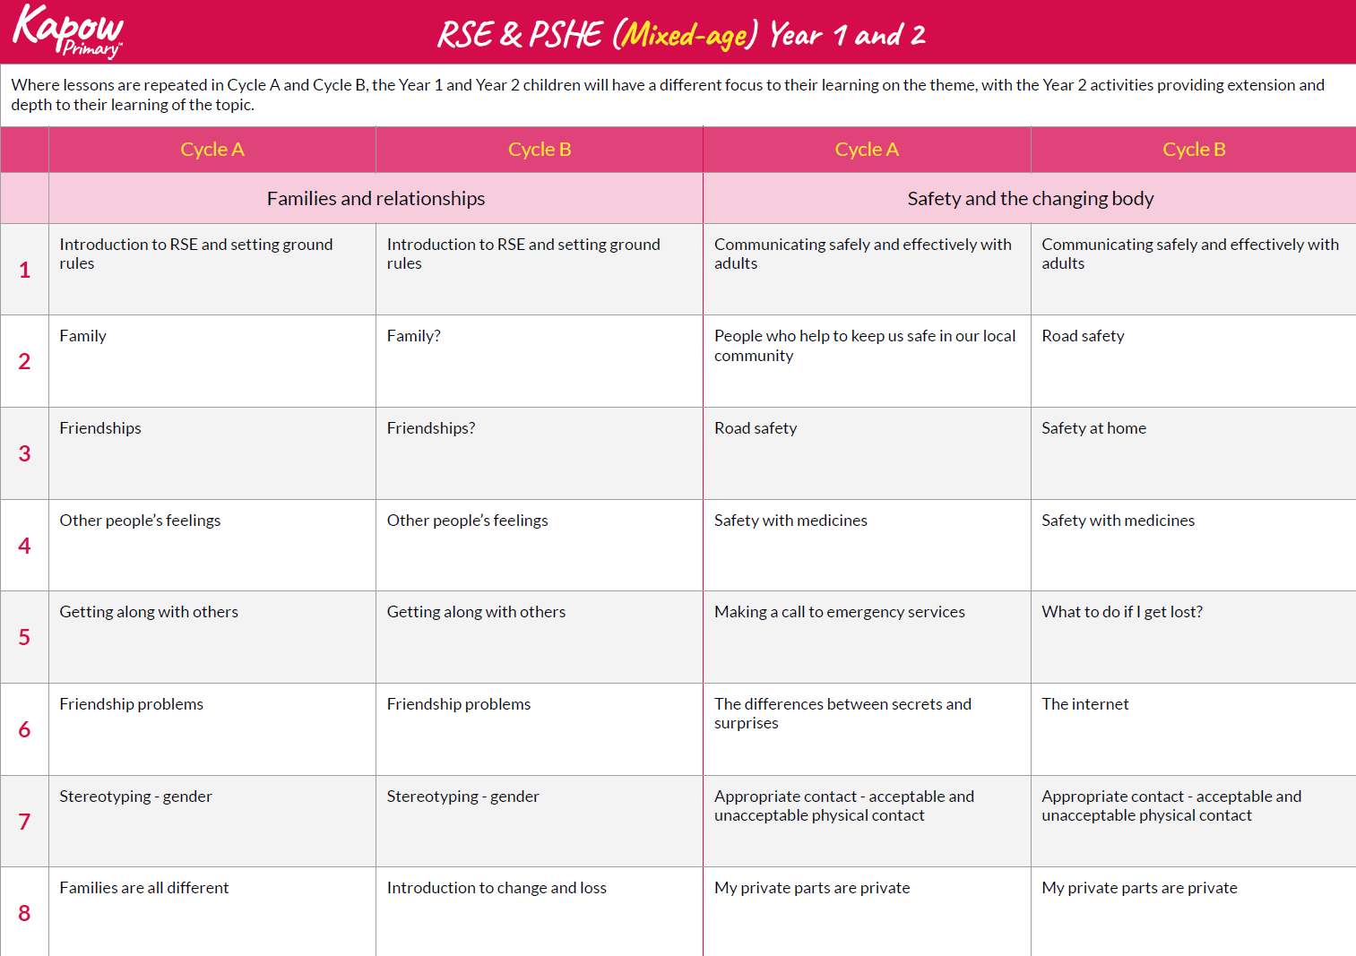
Mixed-age plan
The mixed-age plan organises and adapts the scheme to a two-year rolling cycle (Cycle A and Cycle B) approach, which ensures full coverage of the statutory requirements.
This document enables you to support progress between year groups, despite the challenges of mixed-age teaching in RSE and PSHE.

Slide 12
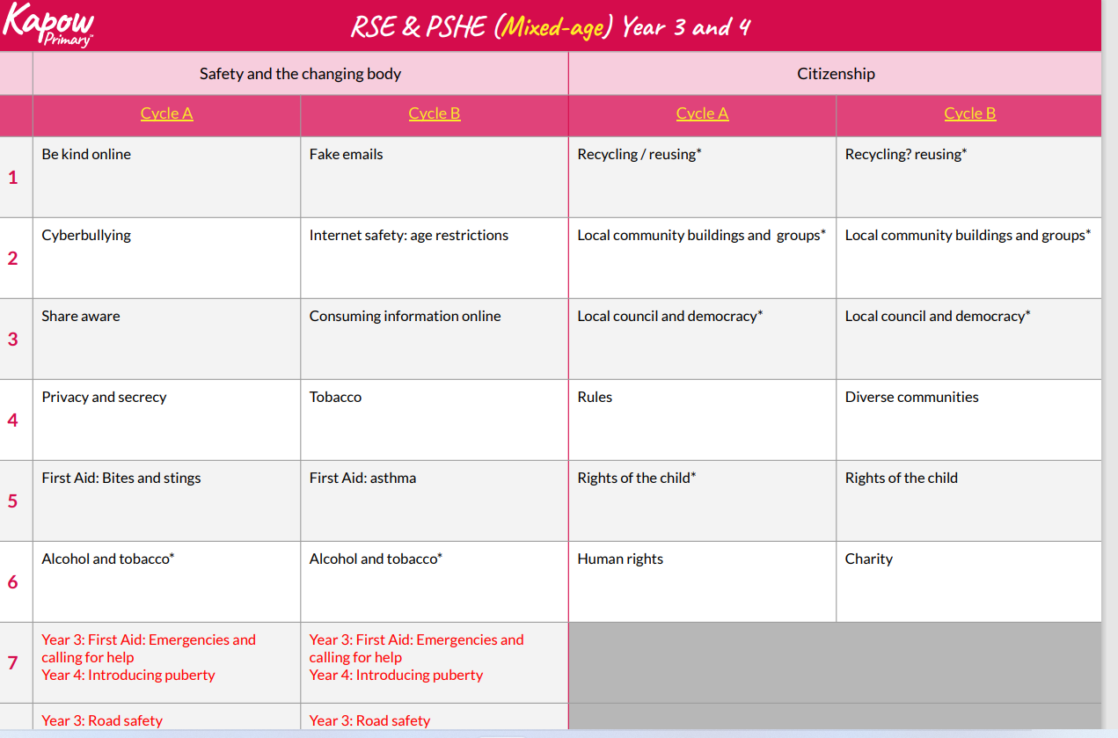

Slide 13
v
Mixed-age lesson plan
v
v
Kapow Primary website

Slide 14
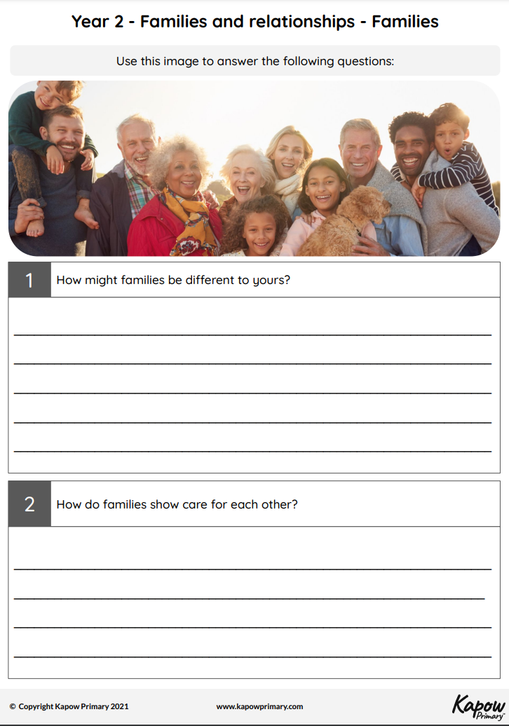
Assessment

Slide 15
Other resources
Knowledge organisers
*mixed-age knowledge organisers for RSE are coming soon in 2022
Knowledge and skills progression document
Key vocabulary

Slide 16
Adapting for your school
Scheme provides a sound base for your teaching, but you know your children therefore you might:
Teach content to both year groups if they need it.
Teach children from the younger age group with the older age groups.
Repeat content.
Add additional lessons if needed.
Split year groups for more lessons.
Notes:
I

Slide 17
Try Kapow Primary for free!
Sign up for a 7-day or 14-day school free trial to access 1000+ lessons and resources for six foundation subjects.
If you have any issues accessing the resources, please contact enquiries@kapowprimary.com
Sign up now

