Slide 1
New Music Subject Leaders – how to ace your role
- with Dr Elizabeth Stafford

Slide 2
Housekeeping:
Your presenter today is primary music expert Dr Elizabeth Stafford.
Elizabeth will be presenting slides on her screen.
Please mute your mic.
You can keep your camera on or turn it off.
The session will finish with your questions. Please type any questions into the chat box any time during the session, and they will be addressed at the end.
Please note this session will be recorded. Recordings and slides will be made available to Kapow Primary customers.

Slide 3
Poll
What are the main challenges of a music subject leader’s role?
Notes:
I have added this to the zoom poll- Heather.

Slide 4
What is the role?
Responsibility for ensuring that the music curriculum is planned, delivered and assessed effectively.
Responsibility for representing the school in a Deep Dive process as part of an Ofsted inspection when required.
ADDITIONALLY:
Responsibility for organising, maintaining and promoting an extra-curricular programme.

Slide 5
Your vision for music
In the chat, type what music in your school is ‘for’

Slide 6
Intent, Implementation and Impact statement
Intent – your vision, aligned to the School Improvement Plan
Implementation – how you will achieve your vision
Impact – what children will be able to do

Slide 7
Curriculum Design
Key knowledge for Subject Leaders

Slide 8
Curriculum design
Know the content of the National Curriculum and ensure that you are meeting its requirements (Kapow Primary is fully NC compliant!).
Understand the concept of the spiral curriculum, and that this is best practice for planning music (Kapow Primary is a spiral curriculum!).
Know that practical, skills-based subjects like music are best delivered regularly, not on a carousel or in a block. (Kapow Primary is designed for regular weekly lessons – although it could be used in other structures!).
Understand the concept of ‘musical knowledge’ and how this differs from a ‘knowledge rich’ approach to curriculum design.

Slide 9
Music and the Spiral curriculum
The idea of a spiral curriculum is well-established in music with a history dating back at least 60 years.
The basic principle is that over time we revisit topics, subjects or themes to deepen pupils’ understanding:
Topics are repeated.
There are increasing levels of difficulty.
New learning is related to previous learning.
The competence of students increases.
(Harden & Stamper, 1999)

Slide 10
Musical development
Know about the mainstream models of musical development (most of which start with the work of Keith Swanwick!).
Know about and have read the Ofsted Music Subject Research Review, published this week.
Understand how progression of skills is planned for within your own curriculum.

Slide 11
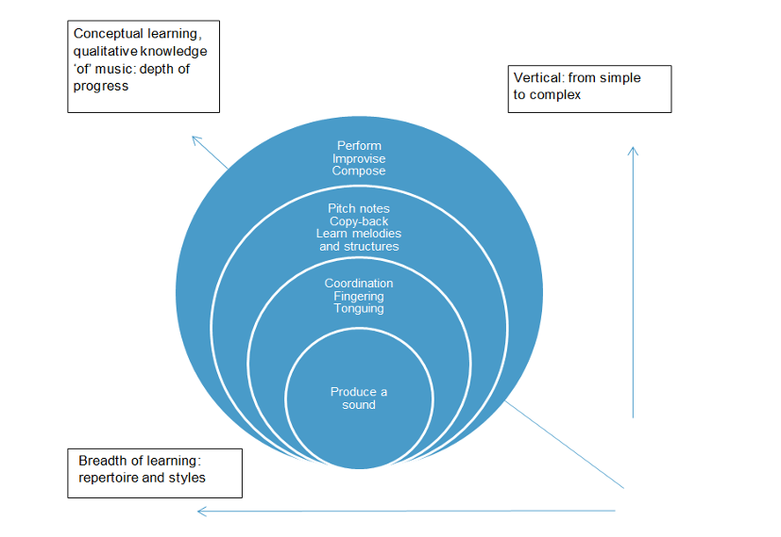
Musical development – a visual model
(Charlton, 2019)

Slide 12
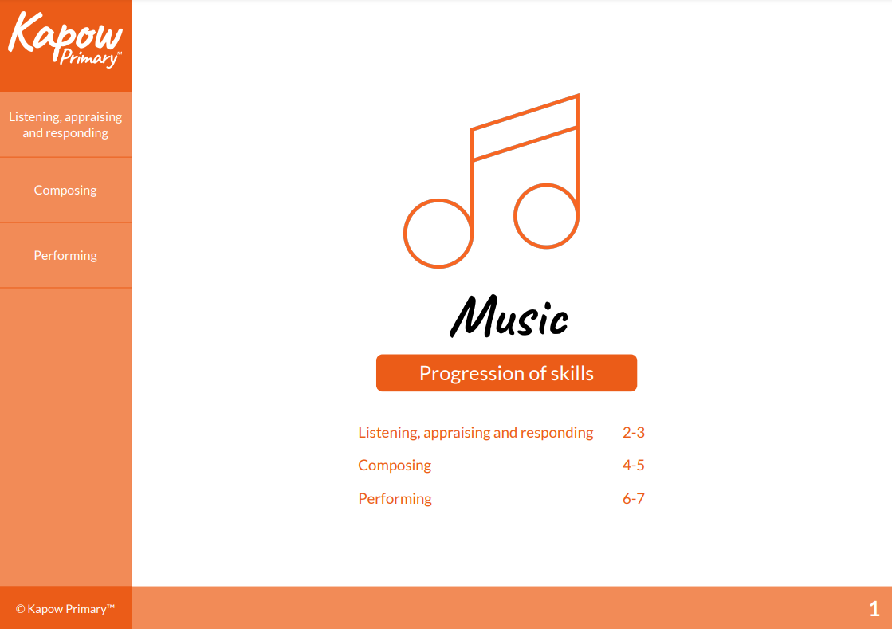
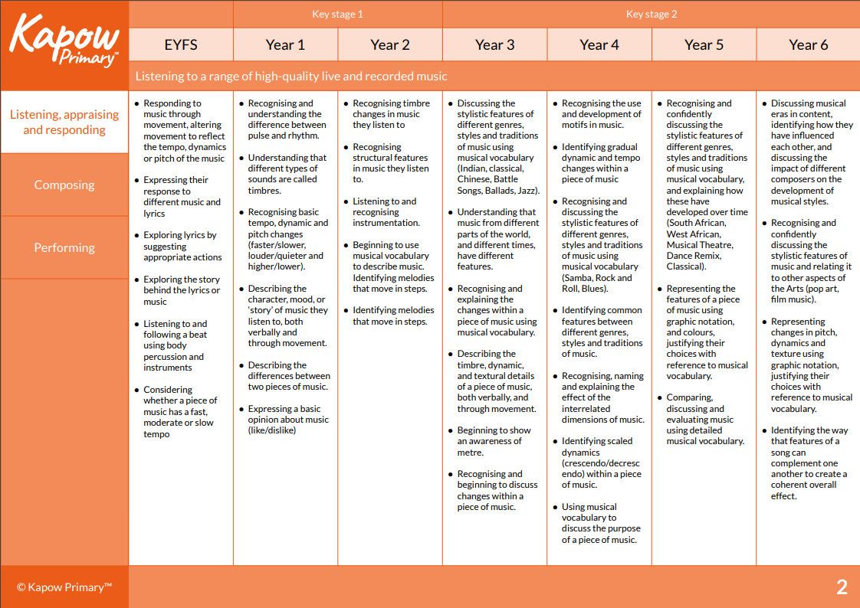
Progression of skills

Slide 13
Curriculum Delivery
Key actions for Subject Leaders

Slide 14
Developing teacher understanding & skill
Start by finding out how staff feel about music!
Carry out an audit of staff understanding and skills, using a questionnaire or other self-assessment tool. (Kapow Primary provides a template for this in their subject leader toolkit).
Demonstrate, team-teach, observe.
Make a plan to make things better, including access to CPD in a range of different formats (including Kapow Primary’s lesson videos!).

Slide 15
Developing differentiation strategies
Differentiation in music is practical, noisy, and can require a high level of subject specific knowledge from the teacher.
All of this, coupled with the myth that some children are more ‘musical’ than others, means lessons are very often not effectively differentiated!
Modelling of differentiation by the music subject leader in a demonstration lesson or team teaching situation can be advantageous.
The Kapow Primary scheme has inbuilt differentiation strategies for every lesson.

Slide 16
Scaffolding feedback to increase challenge
Performance:
Accuracy
Fluency
Control
Expression
Composing:
Structure
Interrelated dimensions of music
Fit for purpose?
Listening:
Depth of answers
Justification
Use of musical vocabulary

Slide 17
Resourcing the curriculum
The National Curriculum requires that you have access to tuned and untuned instruments.
Ideally you need a full class set of tuned instruments, and more than a class set of untuned (to provide choice).
Instruments need to be easily accessible or they won’t get used!
Kapow Primary provides a list of resources required for each year group so that you can see what is needed.

Slide 18
Deep Dive
Key considerations for Subject Leaders

Slide 19
Preparing for a deep dive
Know and be confident to talk about your music vision and how it links to your school development plan.
Be able to articulate the intent, implementation and impact of music in your school.
Carry out an audit of colleagues’ confidence / skill, be able to identify areas for development in a lesson observation situation, and have produced a plan for addressing any areas of concern.
Be able to show how your curriculum is progressive and how you keep track of pupil progress through assessment evidence.

Slide 20
Extra-Curricular Music
An additional responsibility for Subject Leaders

Slide 21
Preparing an extra-curricular programme
Extend the curriculum
Cover a wide range of genres, styles and traditions
Include performance opportunities
Make it inclusive
Remember you’re (probably) not getting paid for any of this!

