Slide 1
Exploring Kapow’s KS2 Music ‘Ancient History’ Topics
- with Dr Elizabeth Stafford

Slide 2
Housekeeping:
Your presenter today is primary music expert Elizabeth Stafford.
Elizabeth will be presenting slides on her screen.
Please mute your mic.
You can keep your camera on or turn it off.
The session will finish with your questions. Please type any questions into the chat box any time during the session, and they will be addressed at the end.
Please note this session will be recorded.

Slide 3
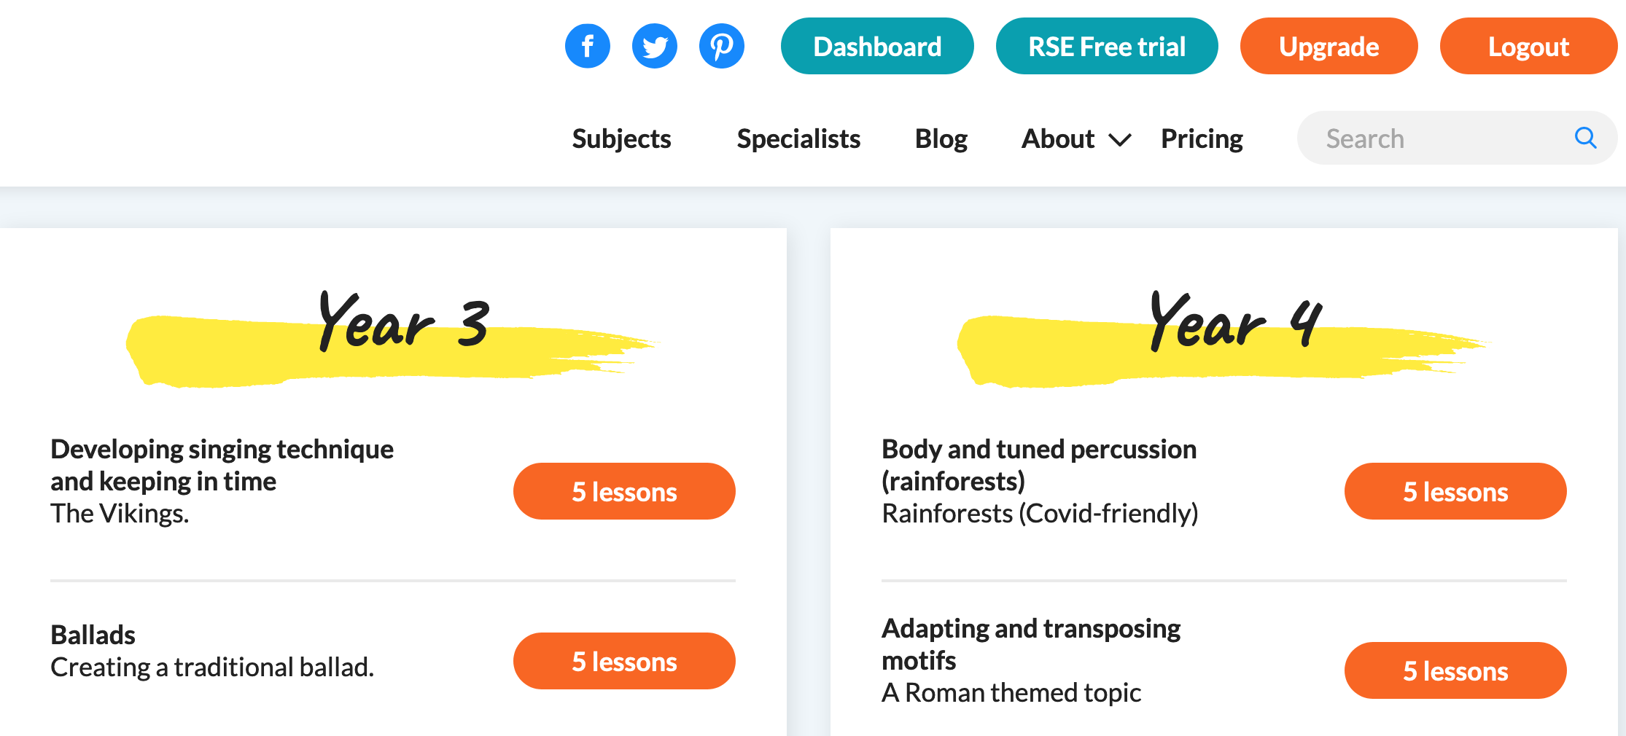
Session Plan
Ancient History: Vikings, Romans and Egyptians
Frequently Asked Questions
Vikings Tour and Taster
Romans Tour and Taster
Egyptians Tour and Taster

Slide 4
Frequently Asked Questions
Why are they in that order?
Can we change the order?
Do we have to be doing this topic to teach these units?
Do we have to do those particular songs to teach these units?
Can we sing in these topics during Covid-19?

Slide 5
Vikings Tour Movement – Singing – Rhythmic Notation – Songwriting - Composing
In this unit we use the Viking Rowing Game to instill and embed a sense of pulse, and gradually over time to develop the coordination needed to play instruments successfully. You can play this game at any time outside of lessons too!
We practise our singing technique using specially written Viking warm-ups and the ‘Dragon Ships’ song, licensed from Out of the Ark. Both these resources then lead into developing an understanding of notation.
Children then work with rhythmic notation to develop their own Viking Battle Songs and perform them using untuned percussion.

Slide 6
Vikings Taster Practical Activities – Zoom Style!
Viking Rowing Game
Viking Vocal Warm-Ups: Vocal Stretches – Tiptoe – Breakfast Chew

Slide 7
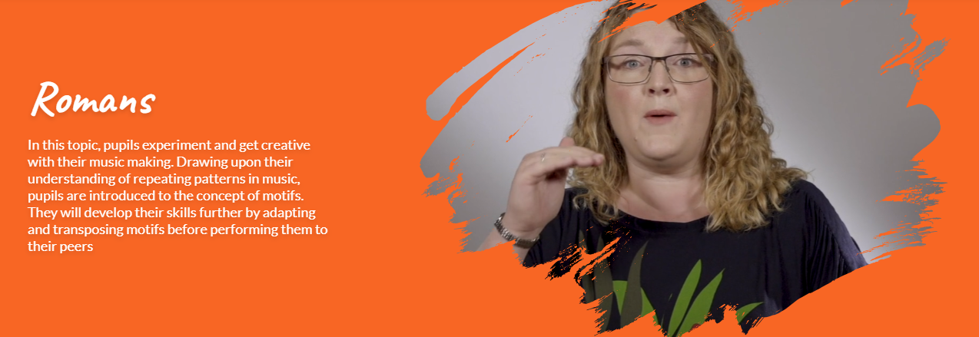
Romans Tour Singing – Melodic Notation – Composing
In this unit we practise our singing technique using specially written Roman themed warm-ups and the ‘Road Building’ song, licensed from Out of the Ark. Both these resources then lead into developing an understanding of melodic notation.
Children then work with melodic notation to create their own motif (a short tune), experimenting with rhythm and note order to vary their motif and add interest to their composition

Slide 8
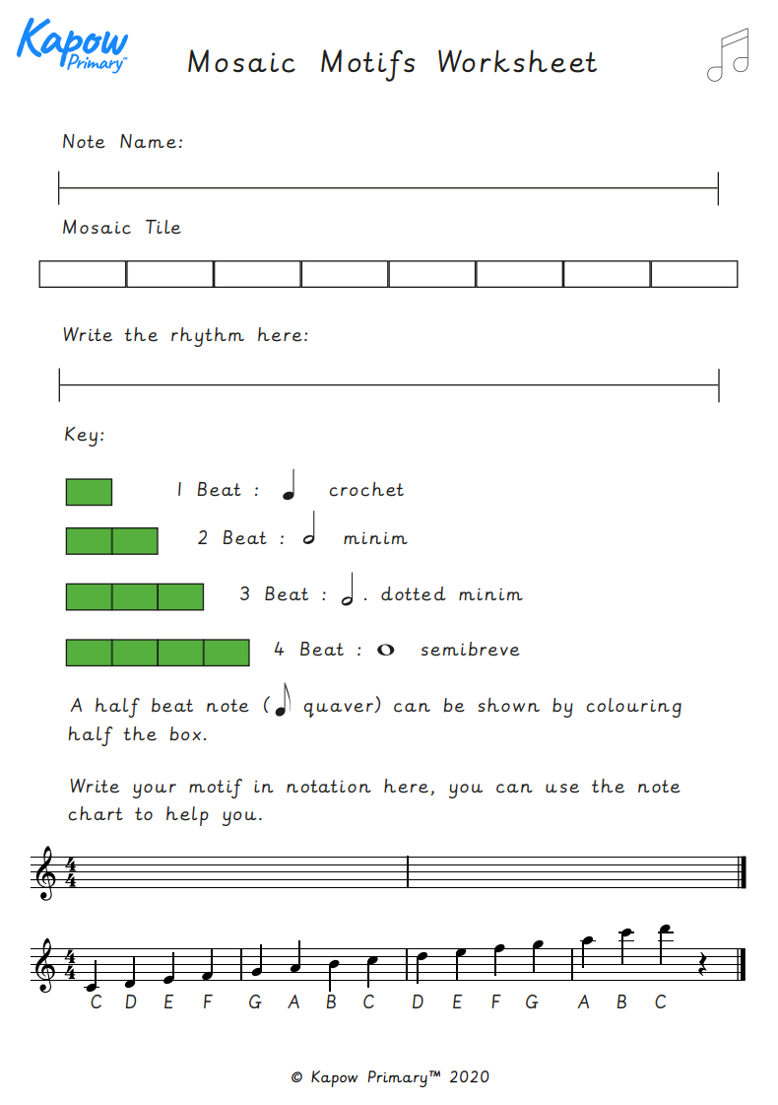
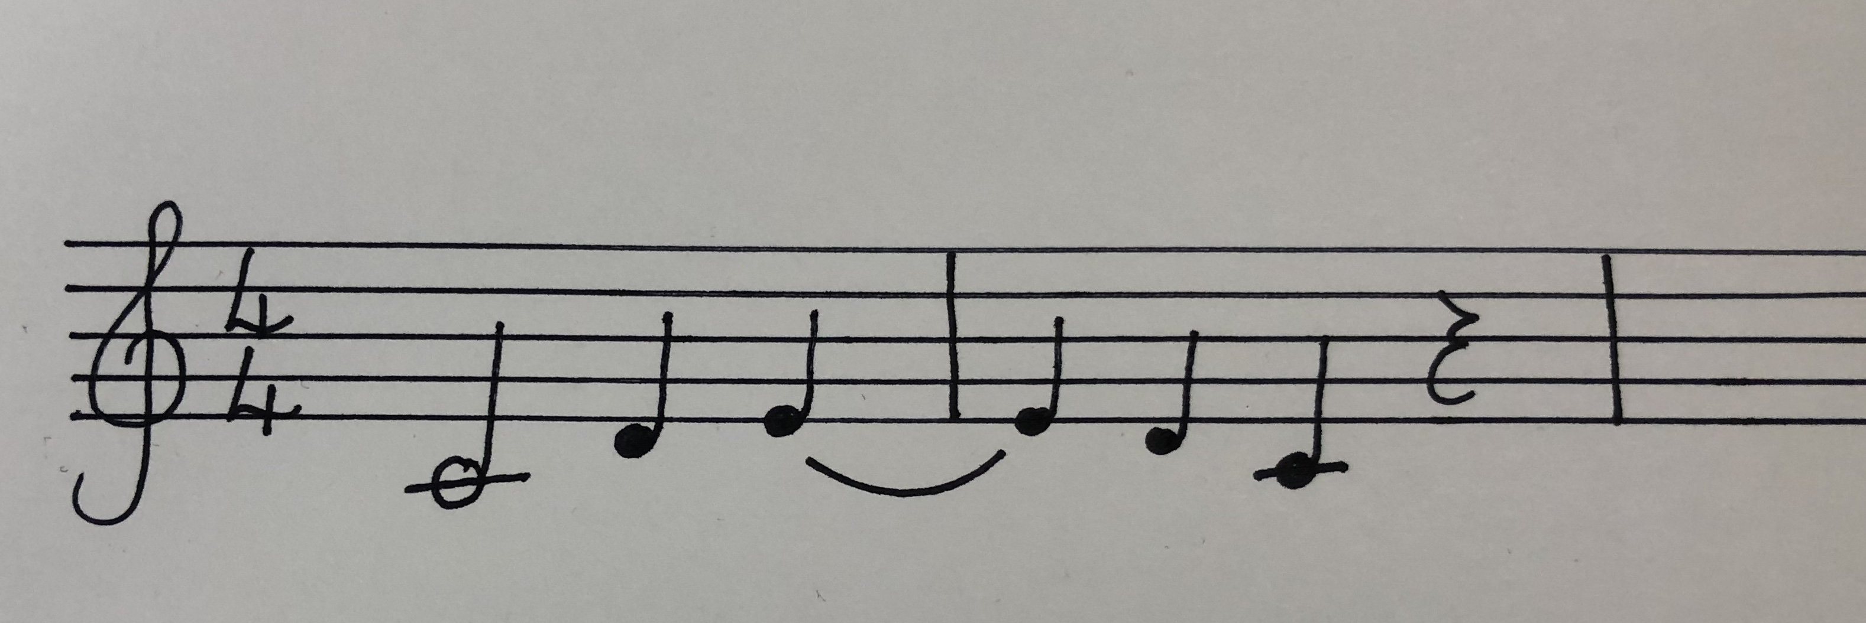
Romans Taster
First we experiment to find a set of notes that we like: C D E D C
Then we write them down on the line
C DE DC
Then we colour in the boxes to show the rhythm
Finally we complete the extension task

Slide 9
Egyptians Tour Singing –Notation – Improvising - Composing
In this unit we practise our singing technique using specially written Egyptian themed warm-ups and the ‘Gift of the Nile’ song, licensed from Out of the Ark. We also practice playing instruments from notation, by playing the instrumental part to the song on whatever tuned instruments you have available, including children’s own.
Children practise their melodic notation reading skills by decoding tunes, and playing them on their instruments, and then have a go at writing their own melody using staff notation.
In the final lesson, pupils will use hieroglyphs to record the structure of their composition, and staff notation to record the melody (or letter notation if struggling).

Slide 10
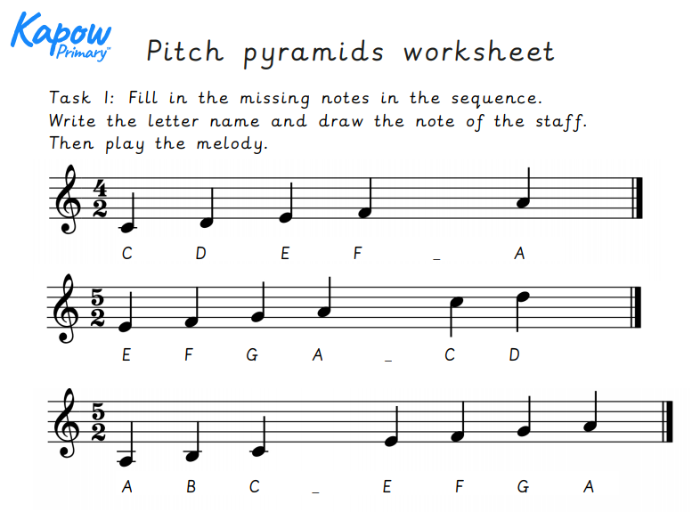
Egyptians Taster Pitch Pyramids

Slide 11
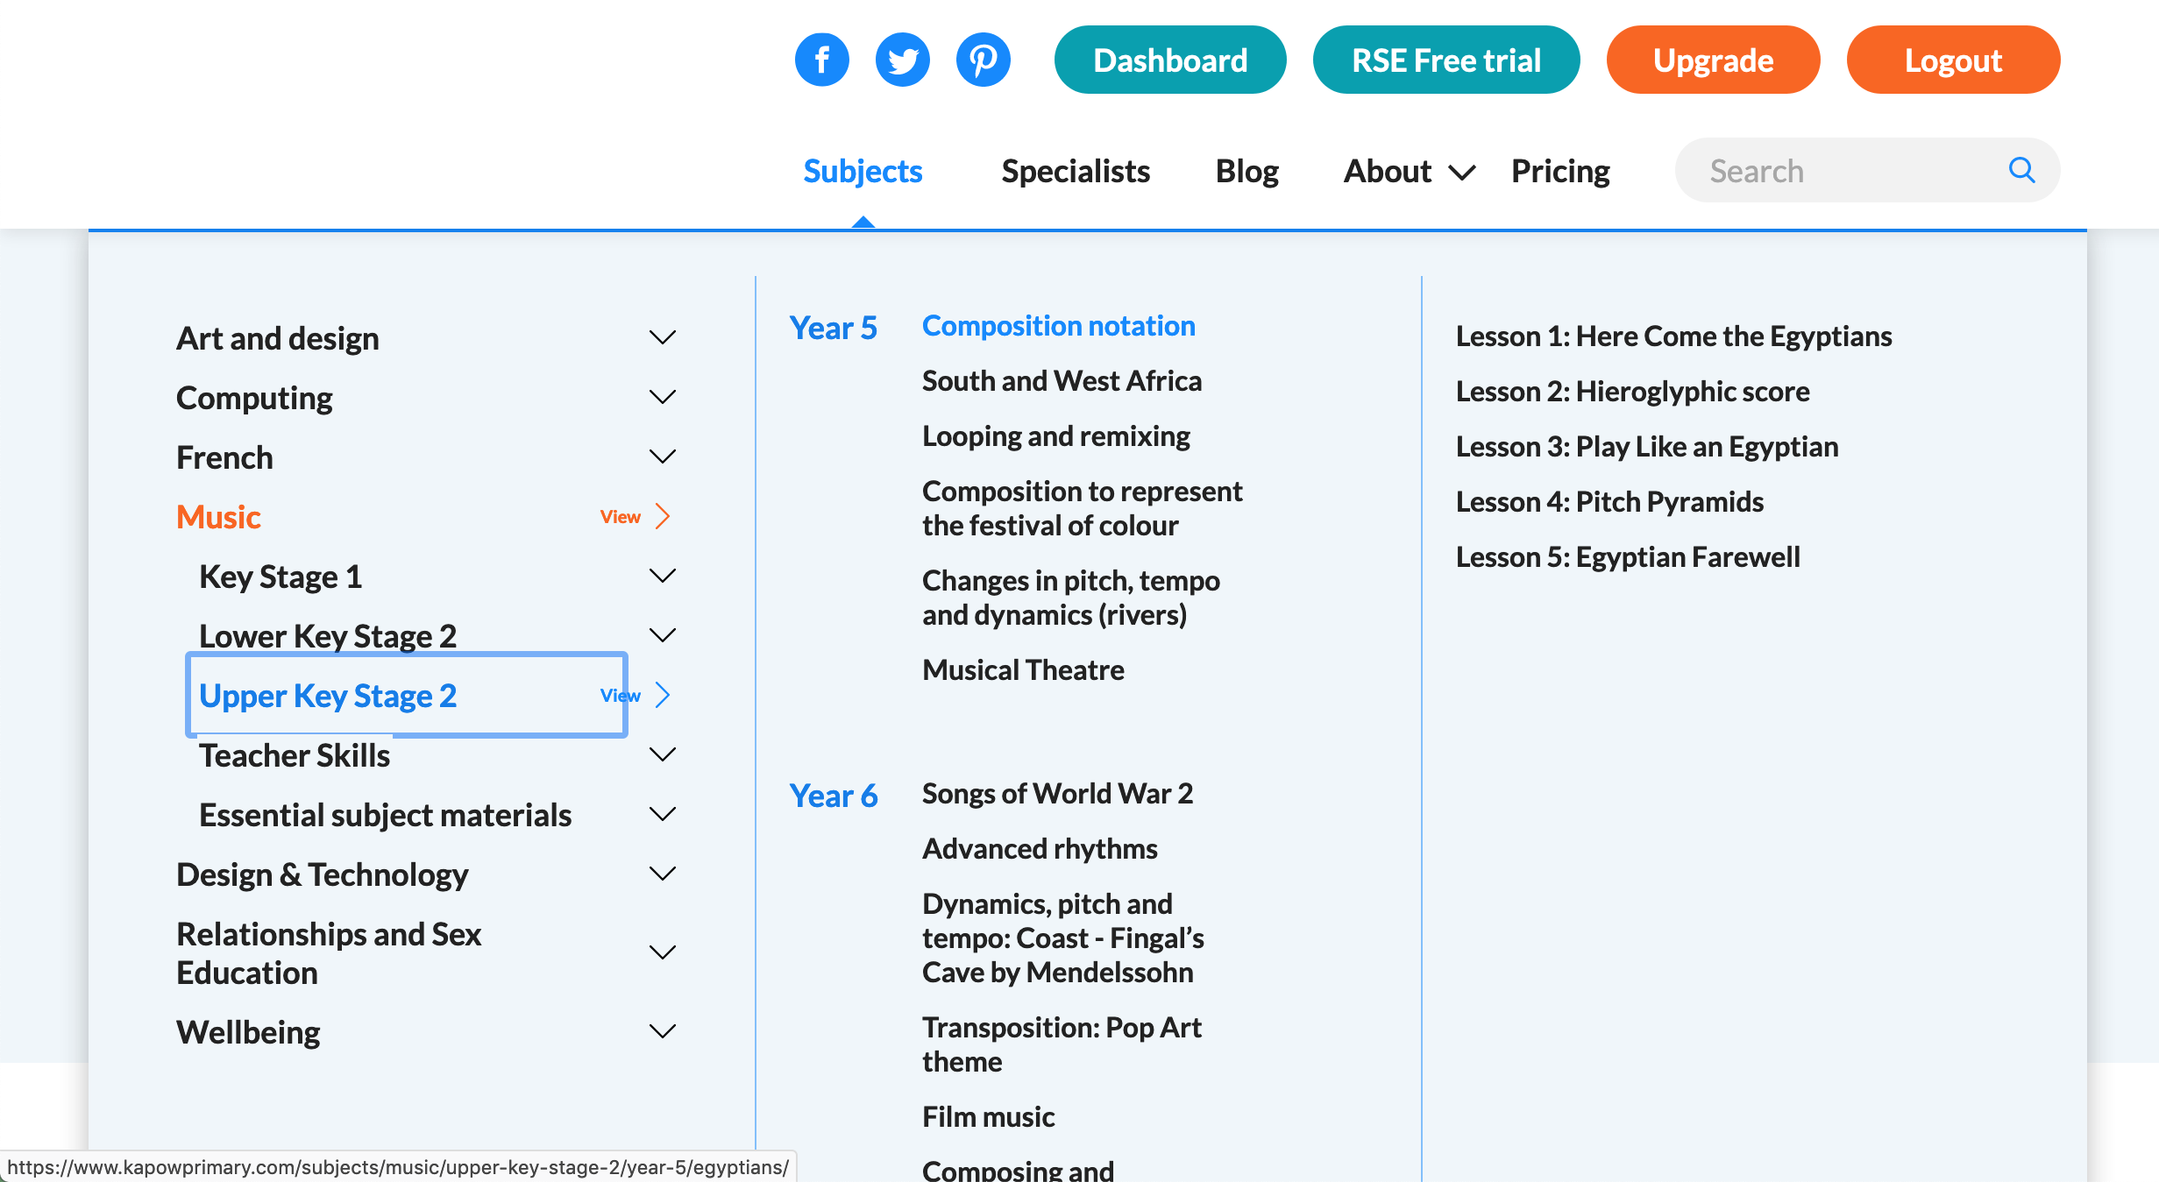
Top tips
Watch the videos!
Practise the activities
Don’t be afraid!

