Slide 1
Welcome to Covid-friendly primary music lessons
- with Sarah Frecknall

Slide 2
Housekeeping:
Your presenter today is primary music expert Sarah Frecknall.
Sarah will be presenting slides on her screen.
Please mute your mic.
You can keep your camera on or turn it off.
The session will finish with your questions. Please type any questions into the chat box any time during the session, and they will be addressed at the end.
Please note this session will be recorded.

Slide 3
Introduction
Government guidance – what does music teaching look like?
Alternatives to singing
Kapow Primary have lessons that can be delivered safely/ adaptable lessons
Top tips

Slide 4
Government guidance
Early August
limited to groups of 15
2 metres between children at all times
all face the front, or back to back formation
Late August
no number limit
adequate ventilation
no prolonged singing
limit shared instruments
limit bubbles mixing or singing together

Slide 5
If not singing, then what? Whole-school situations
Sign language
Sing Up website / Sing Up on YouTube
Body percussion
Amani Utupe - Singing Sherlock book 4
One class sing the song
Poetic reading
Playing on piano as children leave

Slide 6
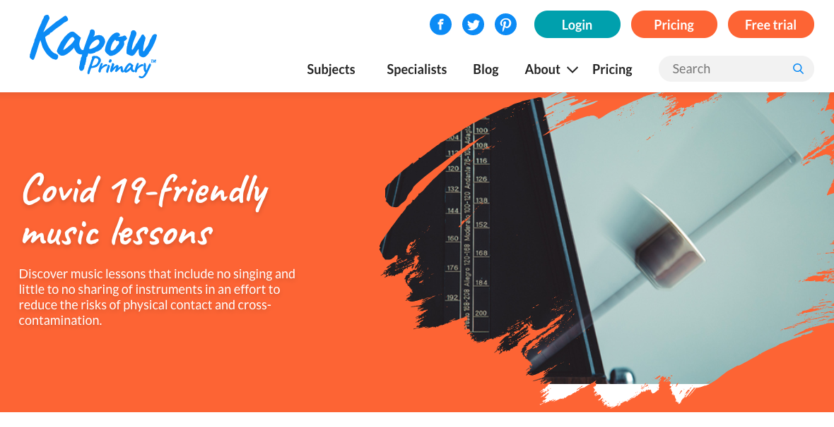
Kapow Primary - Scheme of work
Kapow Primary music lessons
Covid-safe lessons: https://www.kapowprimary.com/covid-19-friendly-music-lessons/
2 lessons for year 1-3
4 lessons for years 4&5

Slide 7
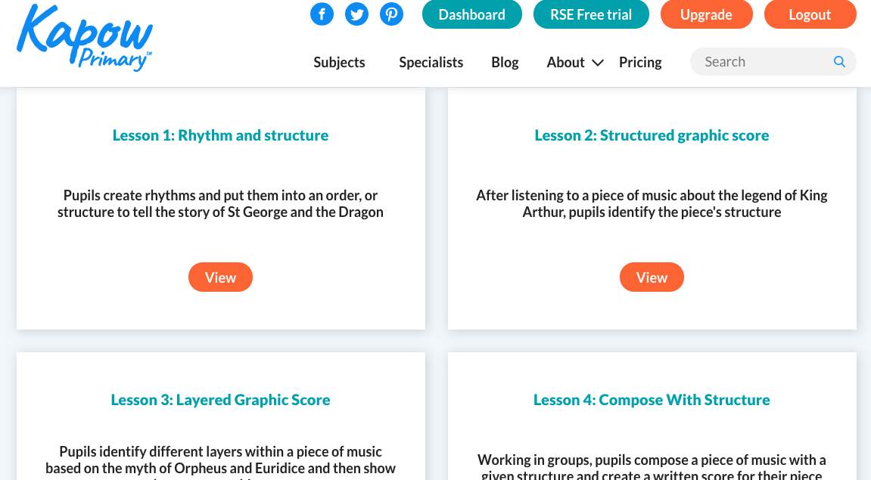
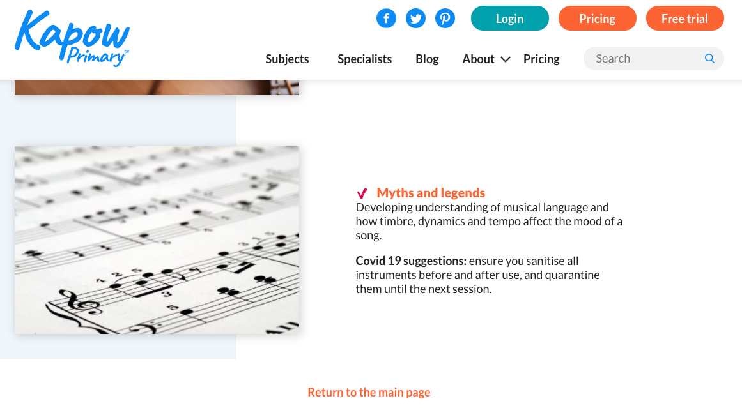
Kapow Primary - Scheme of work
Year 2: Myths and legends
St George & the Dragon
King Arthur
Orpheus & Euridice

Slide 8
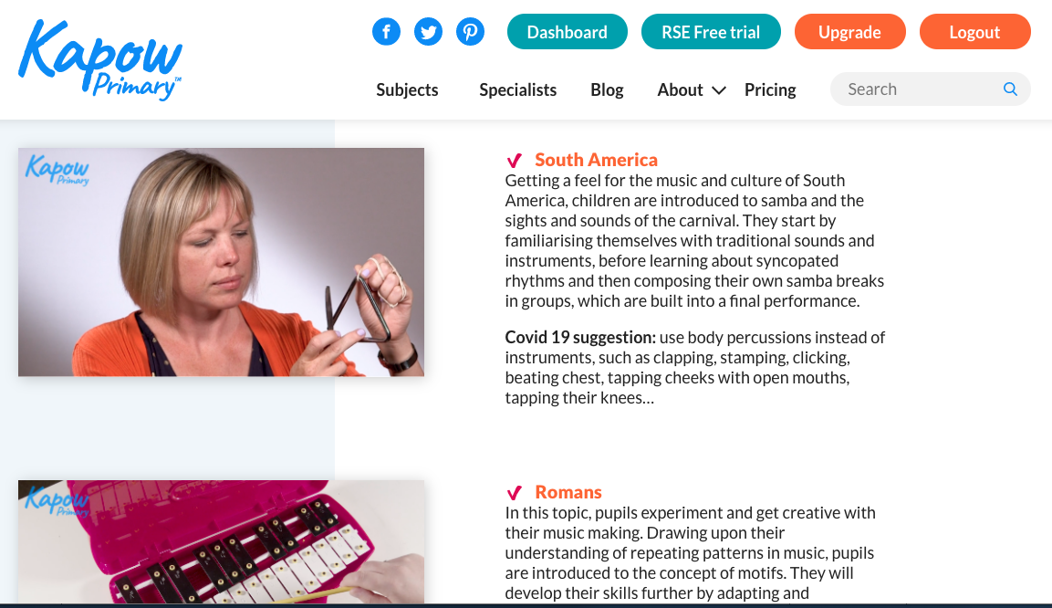
Kapow Primary - Scheme of work
Year 4 – South America
body percussion
Composing
Samba rhythms
Collaboration

Slide 9
Kapow Primary – Scheme of work
Year 5 lessons
4 different topics with suggestions
Year 6
Advanced rhythms
Omit lesson 3 activities (or tap the rhythms instead of singing/ chanting them)

Slide 10
Top tips
Be creative
Be prepared
PE cupboard ☺
Resources I can’t live without…
Class set of claves
Matchsticks
Cups
Rhythm flashcards (Australian Kodaly website)

