Slide 1

Art & Design
Kapow Primary

Slide 2

Teach with confidence with Kapow Primary
Trusted by over 8,300 schools
Engaging and knowledge-rich schemes of work in 12 foundation subjects
Full coverage of national curriculum and statutory guidance
Builds subject confidence through integrated CPD and teacher videos
Varied and memorable lessons including pupil videos and resources
Clear planning, subject leader, Ofsted and assessment documents and tools
By teachers for specialists and non-specialists alike!
Notes:
Add that new subjects are coming soon including R&W, Science, Spanish, PE

Slide 3
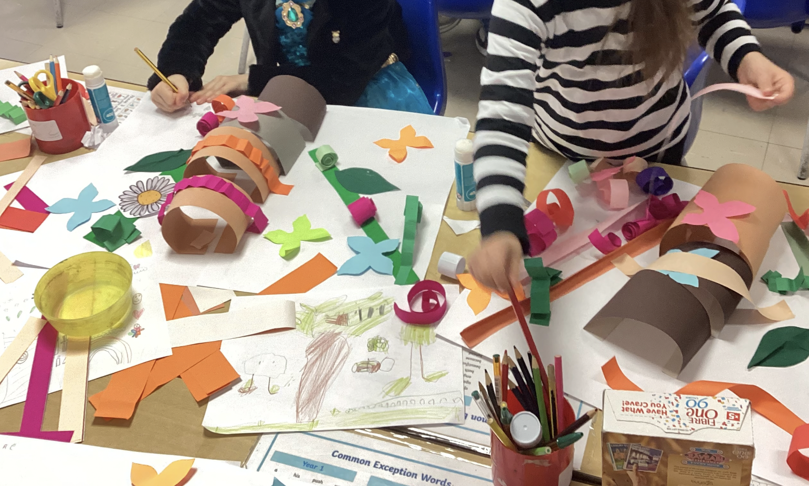
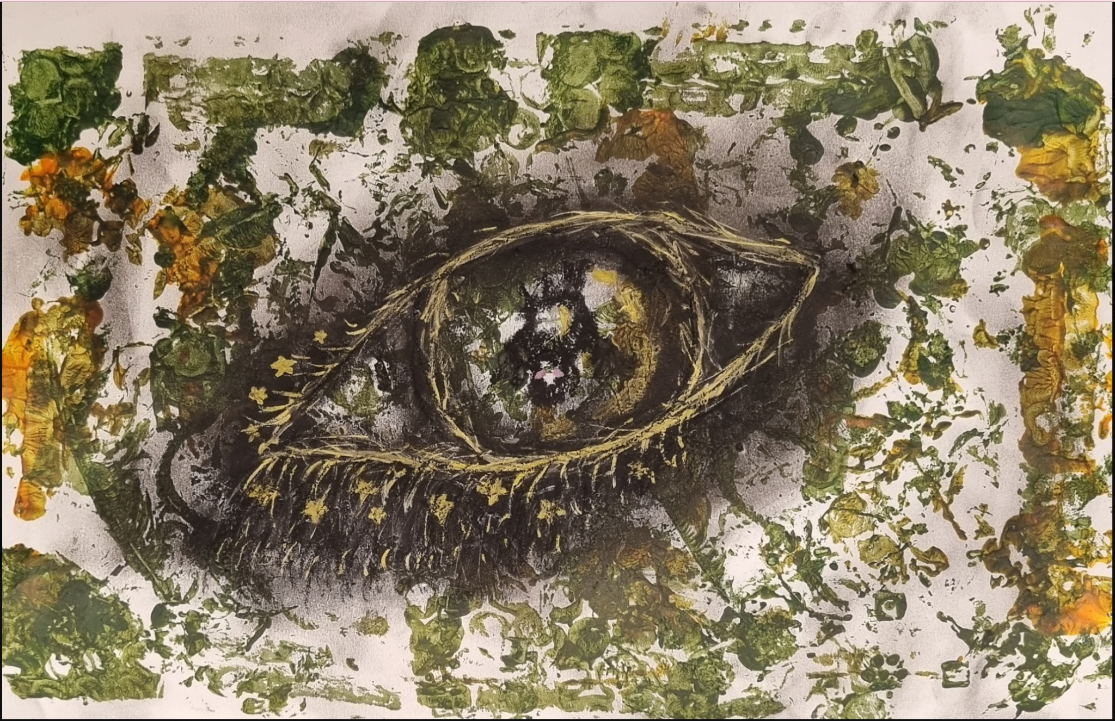

Introducing Art & Design
A progressive scheme of work from Reception to Year 6
Kapow Primary's Art & Design scheme is shaped by dedicated teachers and experts, cultivating creativity and confidence in pupils.
It encourages diverse outcomes by inspiring creativity through expert demo videos and content, allowing pupils to express ideas and explore global art and artists.
We also offer alternative condensed and mixed-age lesson plans.
Watch this video for more advice on implementing Art & Design!

Slide 4

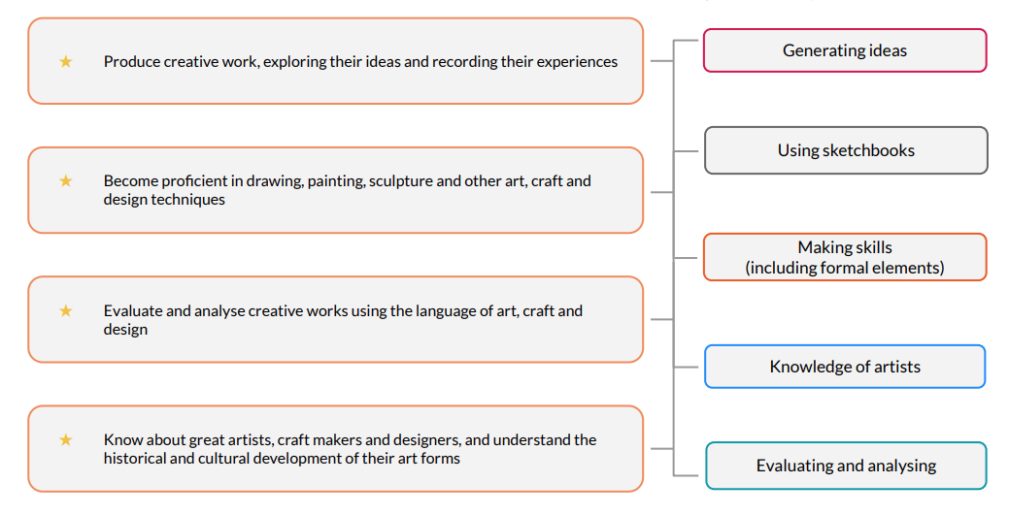
Scheme design
Our scheme of work fulfils the statutory requirements outlined in the National Curriculum (2014) and aims to ensure that all pupils:
In your own time:
See how the full scheme aligns with the national curriculum!
This scheme incorporates five strands to ensure children achieve these aims.

Slide 5
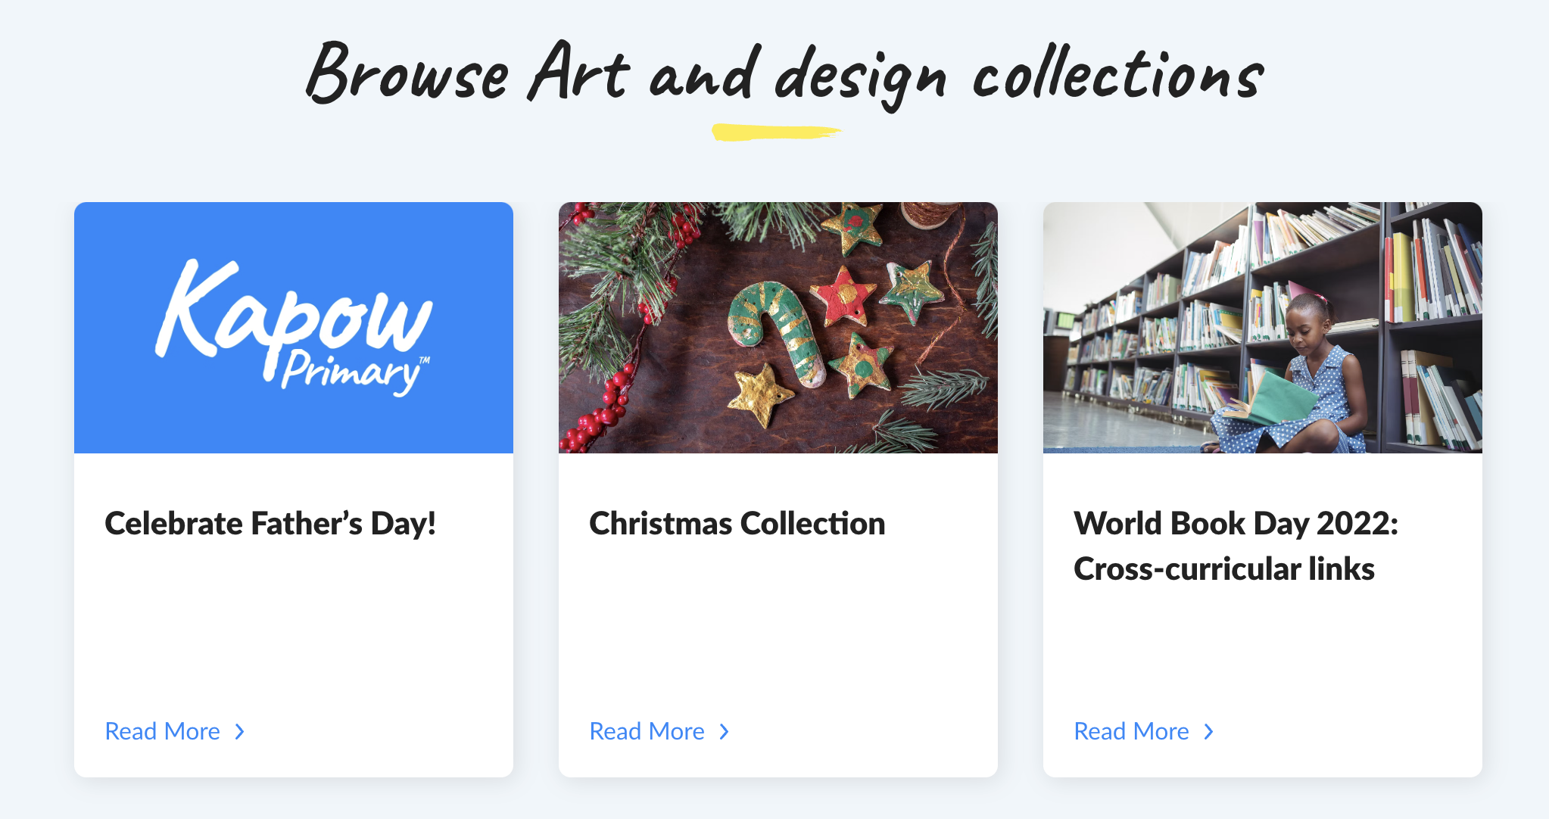
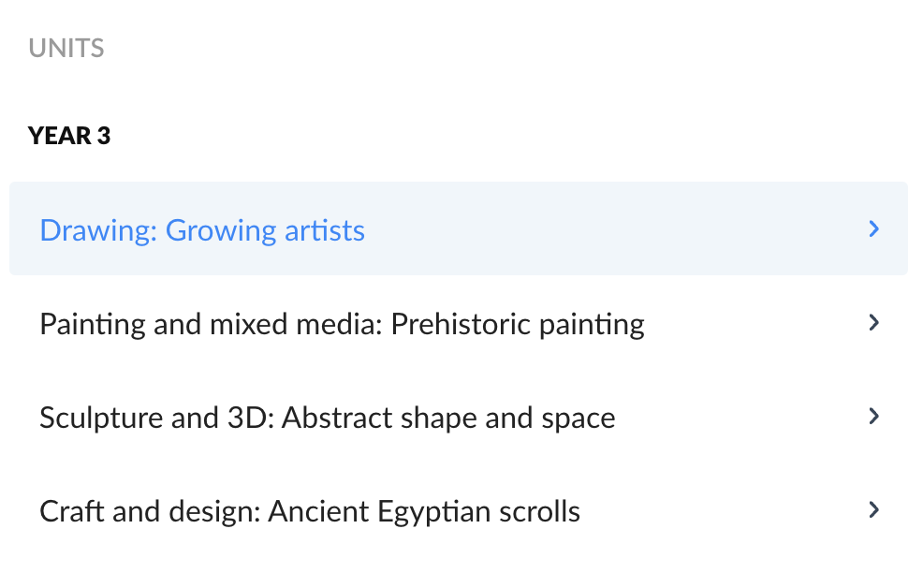
Scheme organisation
In each year group, the scheme is organised into units, covering four key areas:
  Drawing
  Painting and mixed-media
  Sculpture and 3D
  Craft and design
This unit structure offers clear knowledge and skill progression. Each unit consists of five one-hour lessons, providing flexibility for extension or special art days or events.
In your own time:
Our long-term plan demonstrates
how the entire scheme is structured!*
*To access the document, either an Art & Design subscription or free trial is needed.

Slide 6
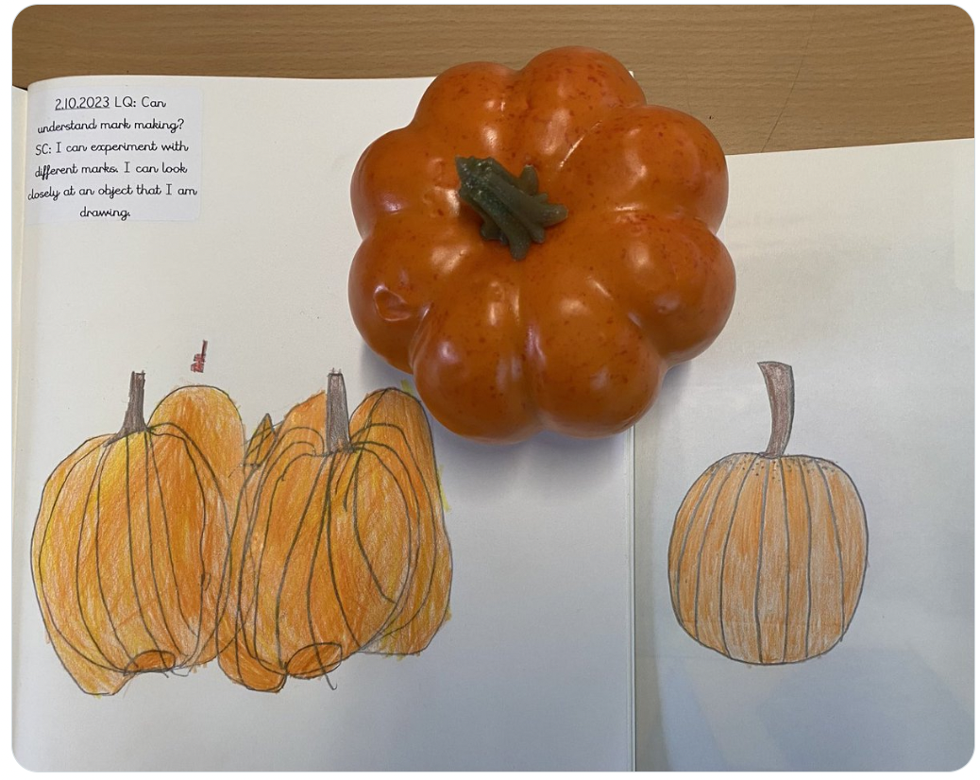
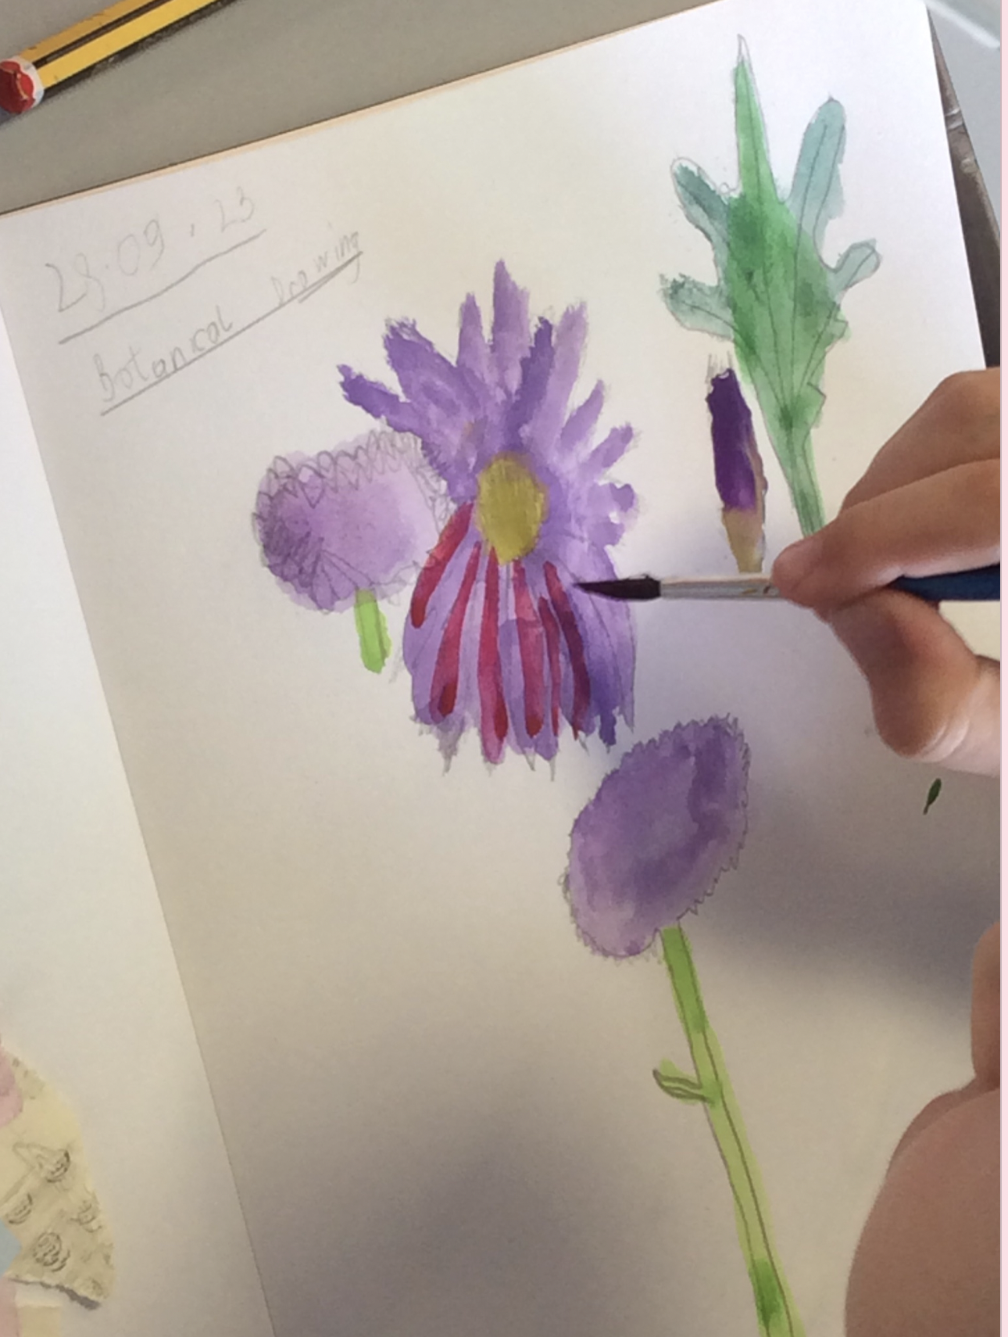
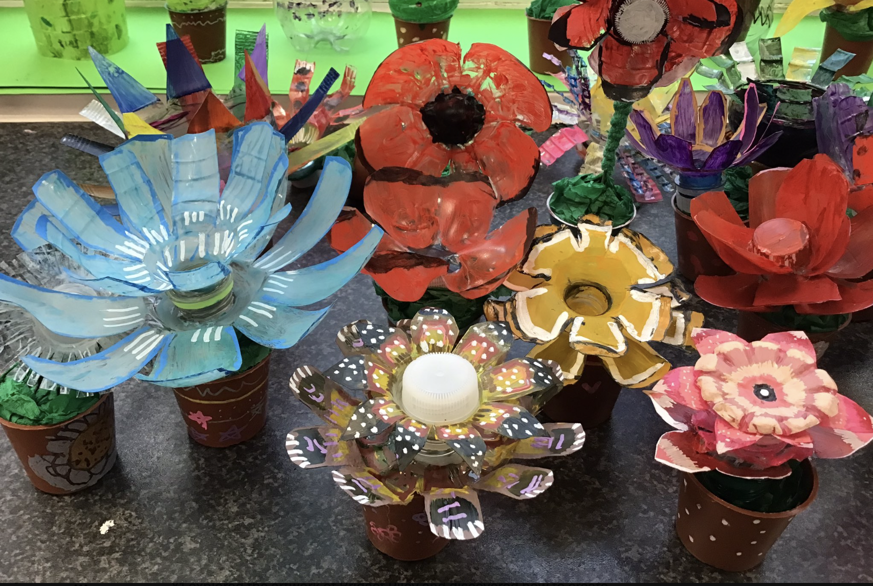
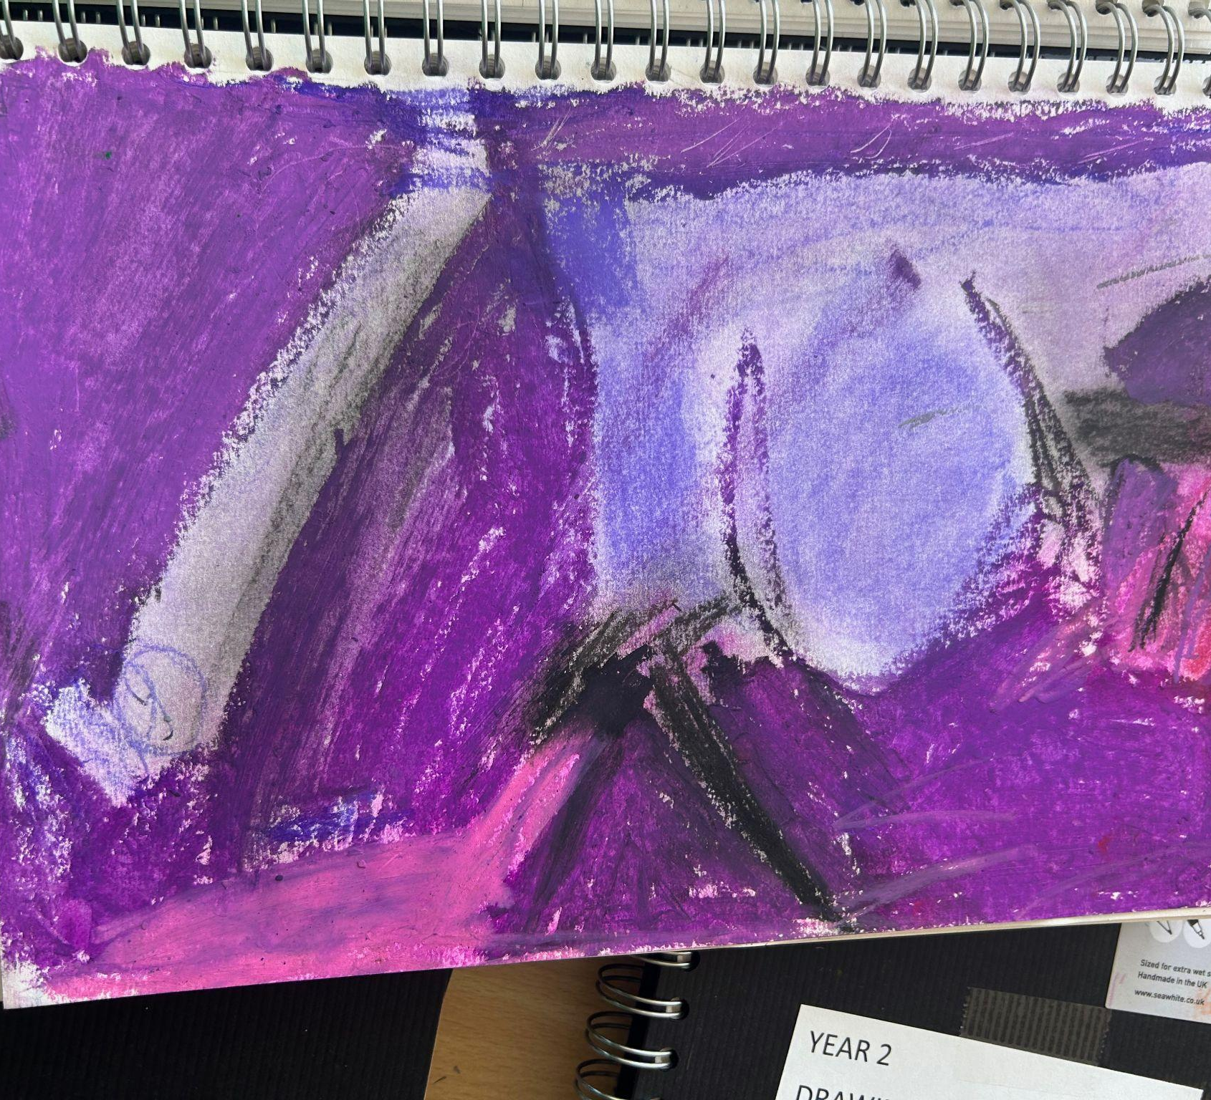
Creativity and independence
“Every child is an artist”
Pablo Picasso
We believe every child is an artist, as said by Pablo Picasso, and we want them to explore art freely.
Our units encourage diverse creative approaches, whilst still being knowledge-rich.
Our practical lessons and use of sketchbooks inspire pupils to explore and experiment, resulting in unique and personal outcomes.
In your own time:
Read our Three I’s statement for more insight!*
*To access the document, either an Art & Design subscription or free trial is needed.

Slide 7
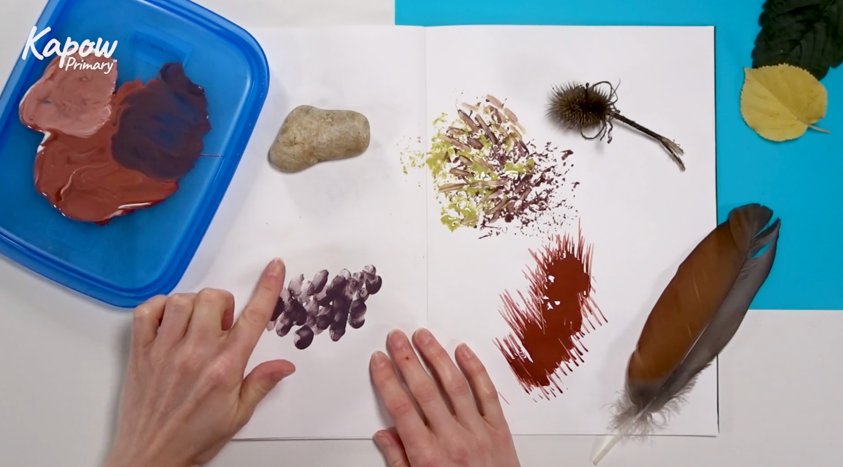
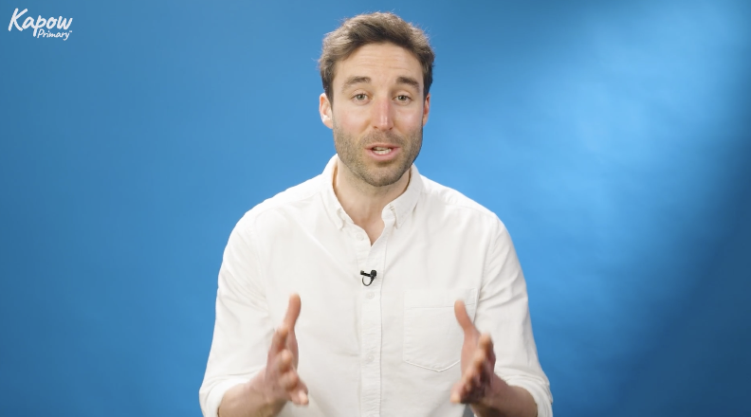
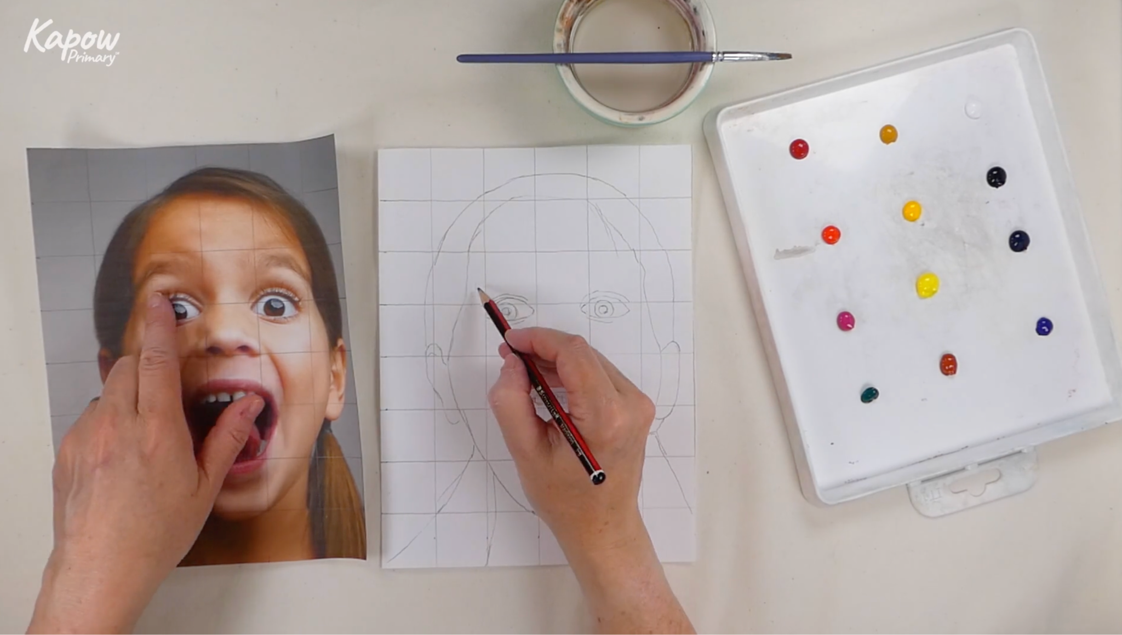
Easy-to-follow demo videos
Our pupil videos allow teachers to show techniques demonstrated by subject specialists.
These videos not only help teachers deliver enjoyable lessons but also ensure the highest quality art education, inspiring pupils to take the lead in their artistic choices.
See for yourself -
watch our Y2 Painting video!*
*To access the video, either an Art & Design subscription or free trial is needed.

Slide 8
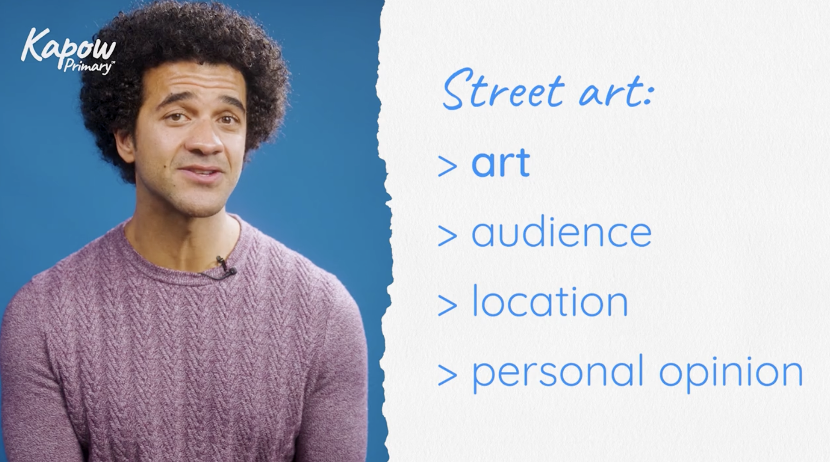
Videos to support CPD
This video is from our Year 6 Drawing unit.
Each unit features bite-sized teacher videos for subject knowledge development and CPD support.
These videos provide guidance, address misconceptions, offer solutions for potential pitfalls, and demonstrate specific technique skills.
Experience the confidence boost
yourself – watch the video!*
*To access the video, either an Art & Design subscription or free trial is needed.

Slide 9


Case study - Barton Moss Primary School
“The teacher videos are fantastic for CPD for our teachers. Our CPD schedule is so packed with everything else, having it integrated into the lessons is just fantastic. Also, the range of art
that we are covering – it is great to hear the
children talk about the different types of
art – and picking up sketchbooks to look
at the outcomes is just wonderful!”
“Kapow Primary has transformed
art at Barton Moss. We now have
an exciting, creative and inspiring curriculum with clear skills progression across the school.
We have confident teachers and children who love art!”
In your own time:
Read more on how Barton Moss increased confidence in Art & Design!

Slide 10






Now it’s your turn to explore Kapow Primary!
Planning resources for
Art & Design
Art & Design
Homepage
Art & Design webinars
Start your FREE trial today!
Find out more information on subscriptions and pricing.

