Slide 1
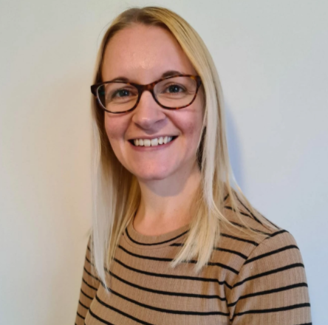
Housekeeping:
Your presenter today is computing specialist Sarah Vaughan.
Sarah will be presenting slides on her screen.
Please mute your mic.
You can keep your camera on or turn it off.
The session will finish with your questions. Please type any questions into the chat box any time during the session, and they will be addressed at the end.
Please note this session will be recorded.

Slide 2
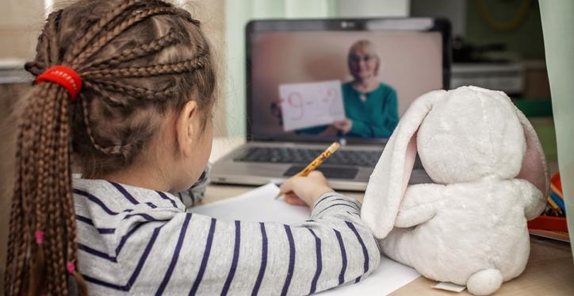
Delivering lessons online: Tips for remote teaching with Kapow Primary
- with Sarah Vaughan

Slide 3
DfE guidance for remote education
https://www.gov.uk/government/publications/whats-working-well-in-remote-education/whats-working-well-in-remote-education?fbclid=IwAR1oGqJulIDI5SZPPrWJHgAHouLZ8KhhrO7XAqQj8iI2vxuFoAdBE0MvY4w#what-is-remote-education
Notes:
https://www.gov.uk/government/publications/whats-working-well-in-remote-education/whats-working-well-in-remote-education?fbclid=IwAR1oGqJulIDI5SZPPrWJHgAHouLZ8KhhrO7XAqQj8iI2vxuFoAdBE0MvY4w#what-is-remote-education

Slide 4
What is remote education?
There are different definitions out there, but these are the ones we will use here:
Remote education: a broad term encompassing learning that happens outside of the classroom, with the teacher not present in the same location as the pupils.
Digital remote education: often known as online learning, this is remote learning delivered through digital technologies.
Blended learning: a mix of face-to-face and remote methods. An example would be the ‘flipped classroom’, where main input happens remotely (for example through video), while practice and tutoring happen in class.
Synchronous education: this is live; asynchronous education is when the material is prepared by the teacher and accessed by the pupil at a later date.
Notes:
https://www.gov.uk/government/publications/whats-working-well-in-remote-education/whats-working-well-in-remote-education?fbclid=IwAR1oGqJulIDI5SZPPrWJHgAHouLZ8KhhrO7XAqQj8iI2vxuFoAdBE0MvY4w#what-is-remote-education

Slide 5
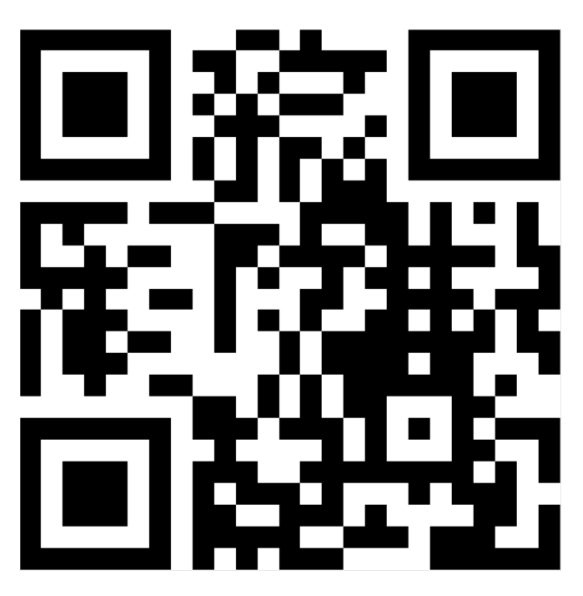
What are you doing for remote education?
Go to www.menti.com and use the code:
70 94 70 7

Slide 6
Which Kapow Primary units work well for remote education?
https://www.kapowprimary.com/home-learning-units/

Slide 7
Live teaching
How are children entering?
Set ground rules with children.
Are they signing off?
Engagement
Time for pupils to work independently and collaboratively.
Resources

Slide 8
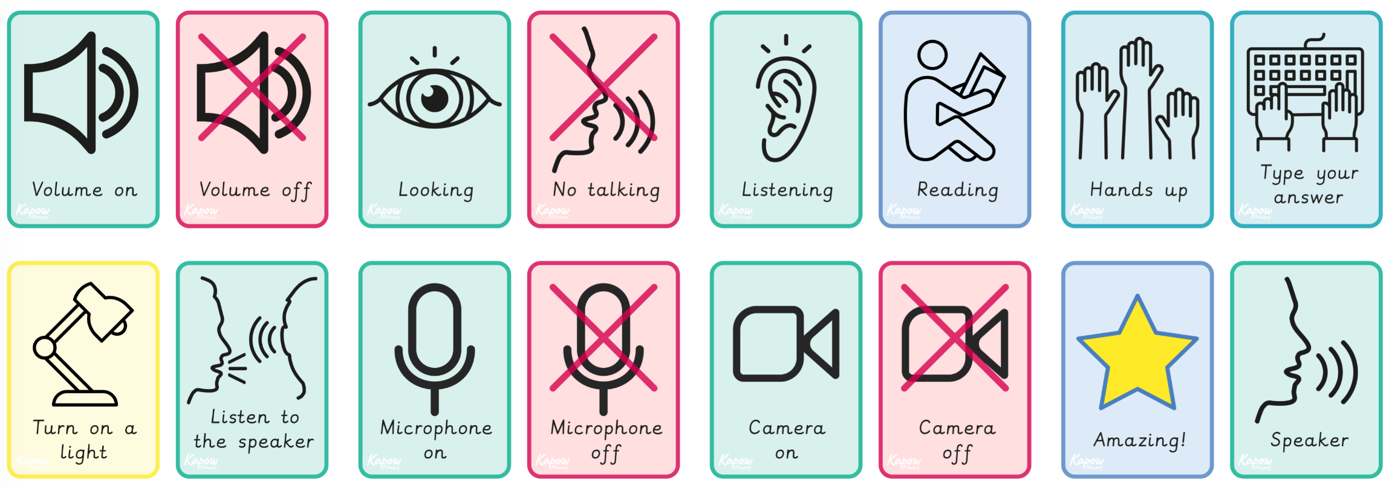
Visuals

Slide 9
Live lesson examples
Computing - Year 1 - Algorithms Unplugged Lesson 2: Algorithm pictures
Art - Year 3 - Formal elements of Art
Lesson 1: Seeing simple shapes

Slide 10
Online quizzes
Kahoot
Live teaching or pre assigned
Free to use
Competitive element
Let’s have a go… got to Kahoot.it (or use the app)
Other quizzes: Google Forms, Microsoft Forms, Quizzizz, Quizlet

Slide 11
Online whiteboards
Jamboard - jamboard.google.com/
Live in Google Meet
Free to use
Collaborative
Whiteboard.fi
Live or pre-recorded
Free to use
Individual boards for the pupils

Slide 12
Pre - recording
NB - Kapow Primary will permit its customers to record the Kapow Primary lessons they need during the school closures (including with the videos playing) as long as the recordings are only shared privately.
There are several options available for pre -recording.
Some have time limits, cost implications.

Slide 13
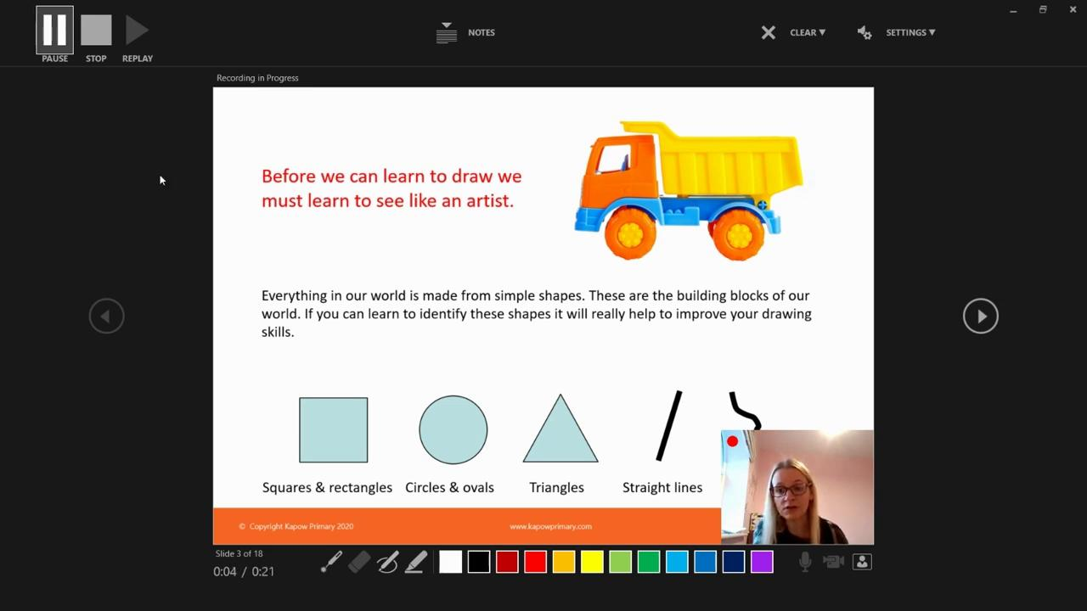
Powerpoint

Slide 14
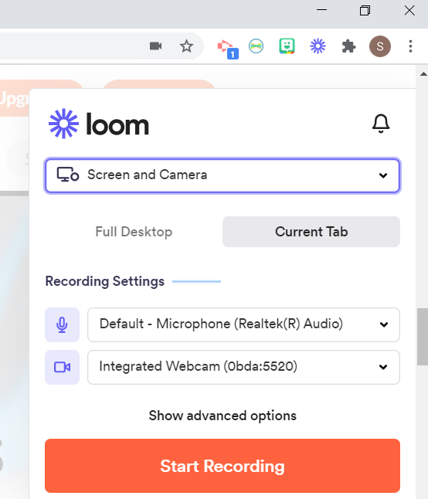
Loom

Slide 15
Loom

Slide 16
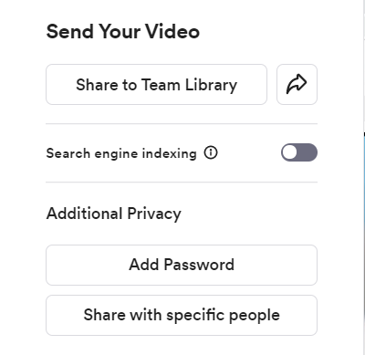
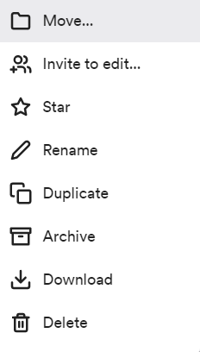
Loom
Notes:
Only post the public link within your own network. E.g. not on your school website or facebook.

Slide 17
Pre - recording
What are you wanting to pre-record? Single tab or multiple?
Engagement with pupils
Where/ how going to upload for pupils
Final video size
Kapow Primary are happy with you recording the lessons you need during school closures, as long as you ensure that the links to these recording are within your secure school network.
Remember for other publishers you need to check with them separately.
Others: Screencastify, Google Meet, Teams, Zoom

Slide 18
Any questions?

