Slide 1
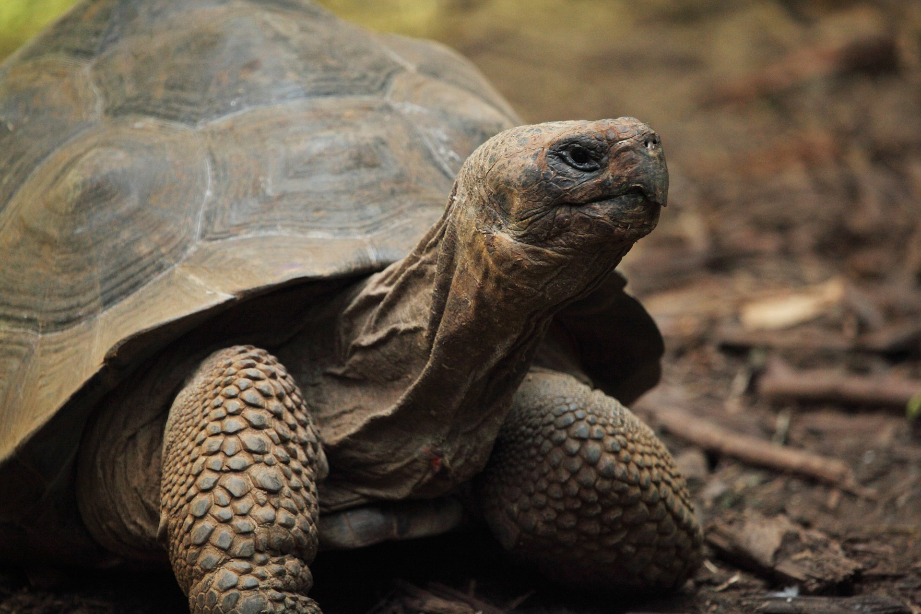
© Copyright Kapow! 2017

Slide 2
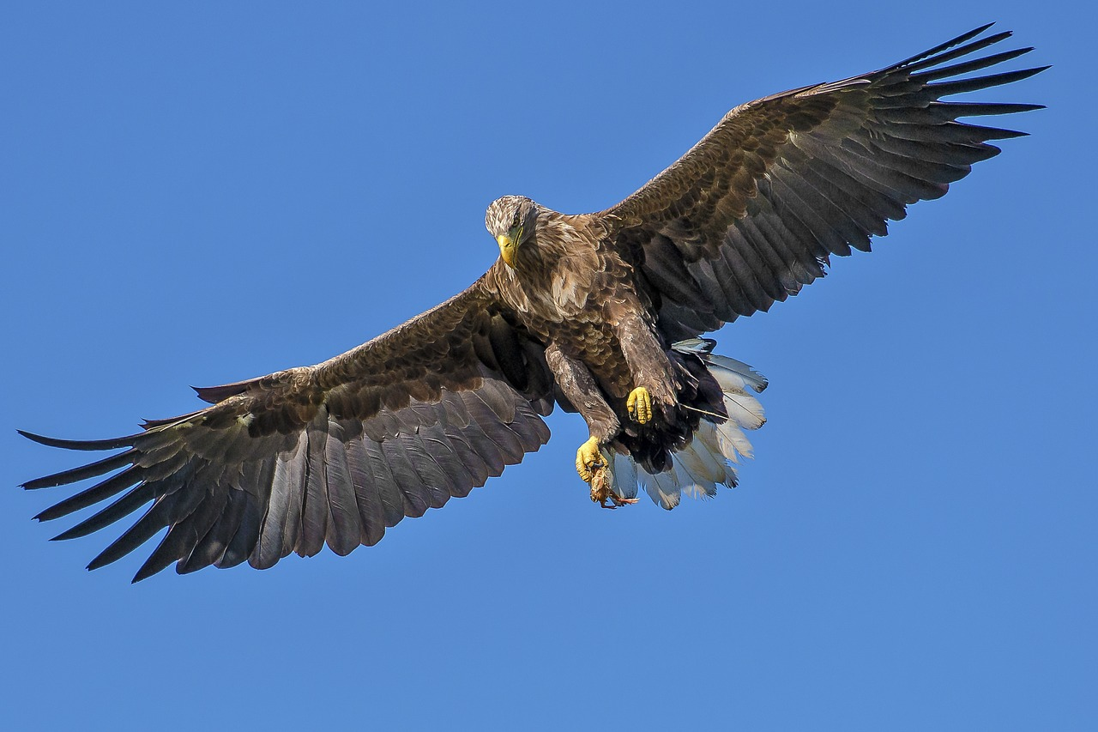
© Copyright Kapow! 2017

Slide 3
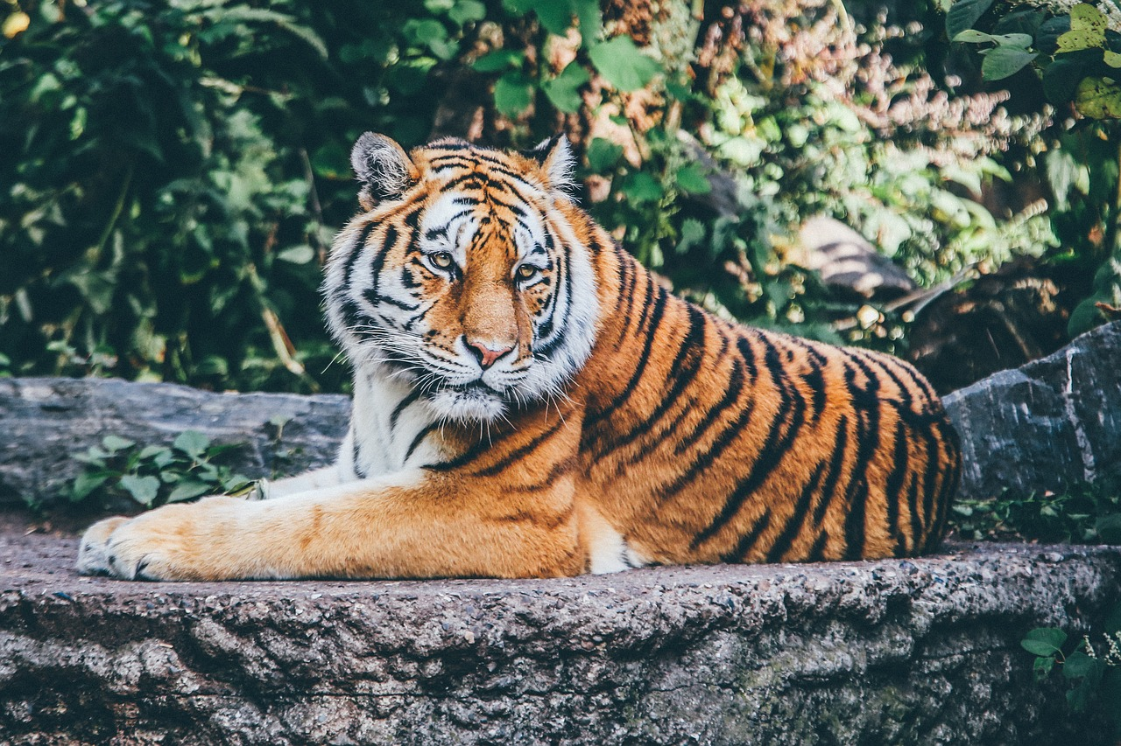
© Copyright Kapow! 2017

Slide 4
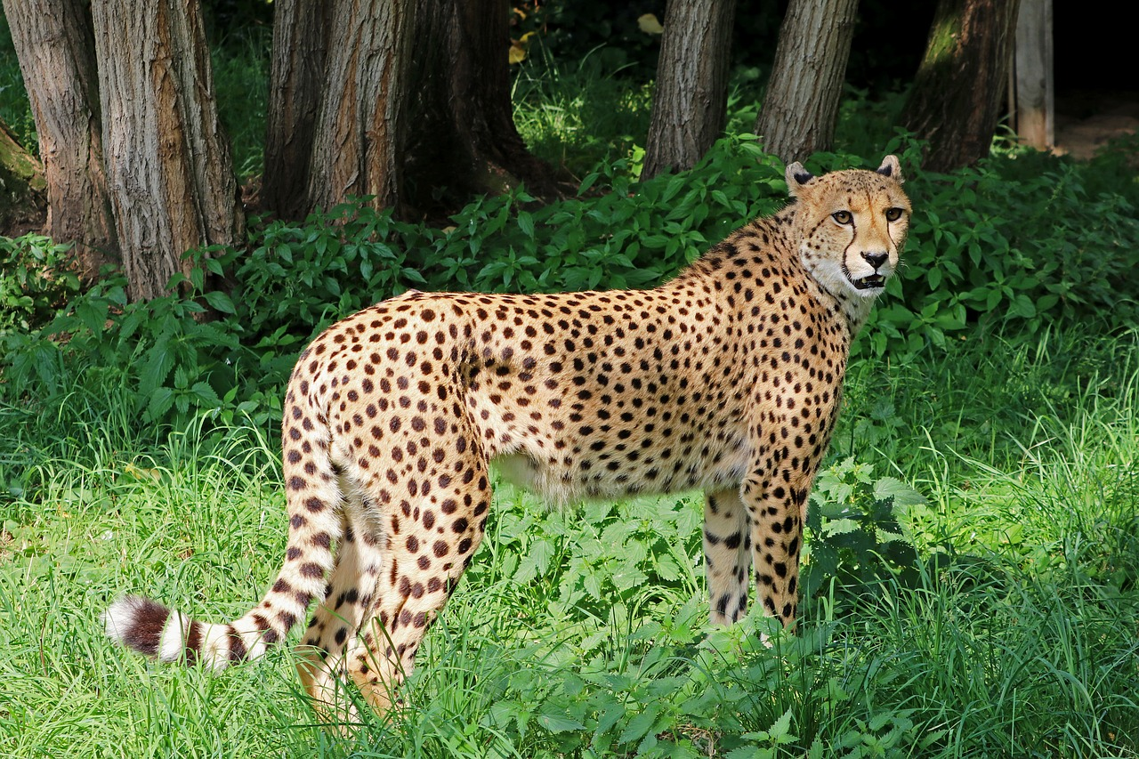
© Copyright Kapow! 2017

