Slide 1
Pattern Ideas
© Copyright Kapow! 2017

Slide 2
© Copyright Kapow! 2017

Slide 3
© Copyright Kapow! 2017

Slide 4
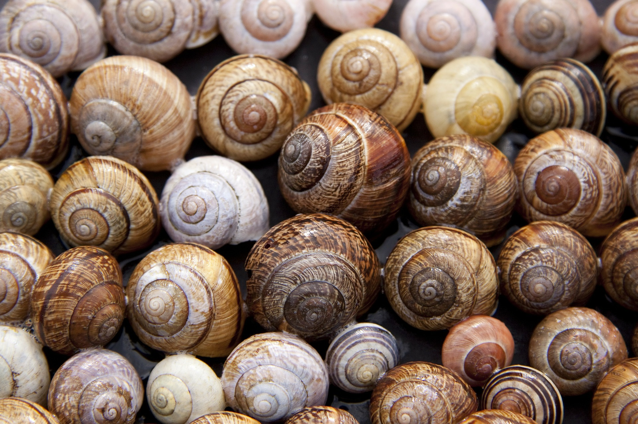
© Copyright Kapow! 2017

Slide 5
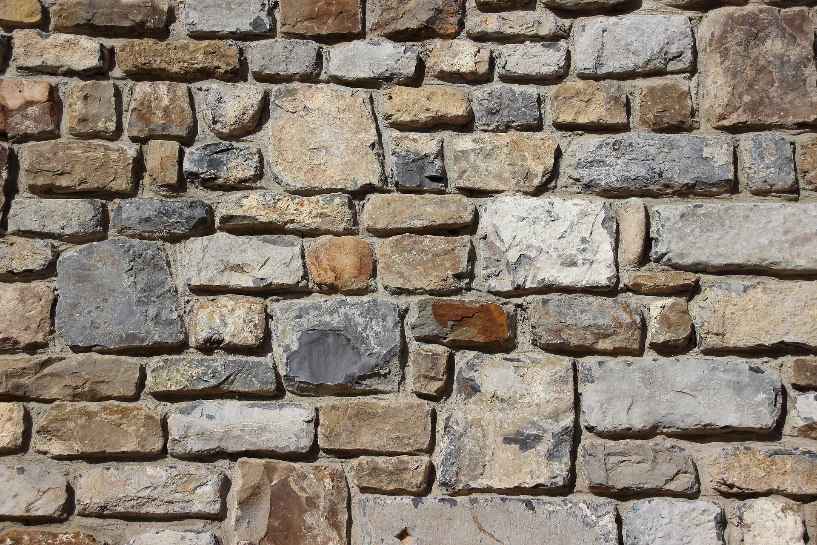
© Copyright Kapow! 2017

Slide 6
© Copyright Kapow! 2017

Slide 7
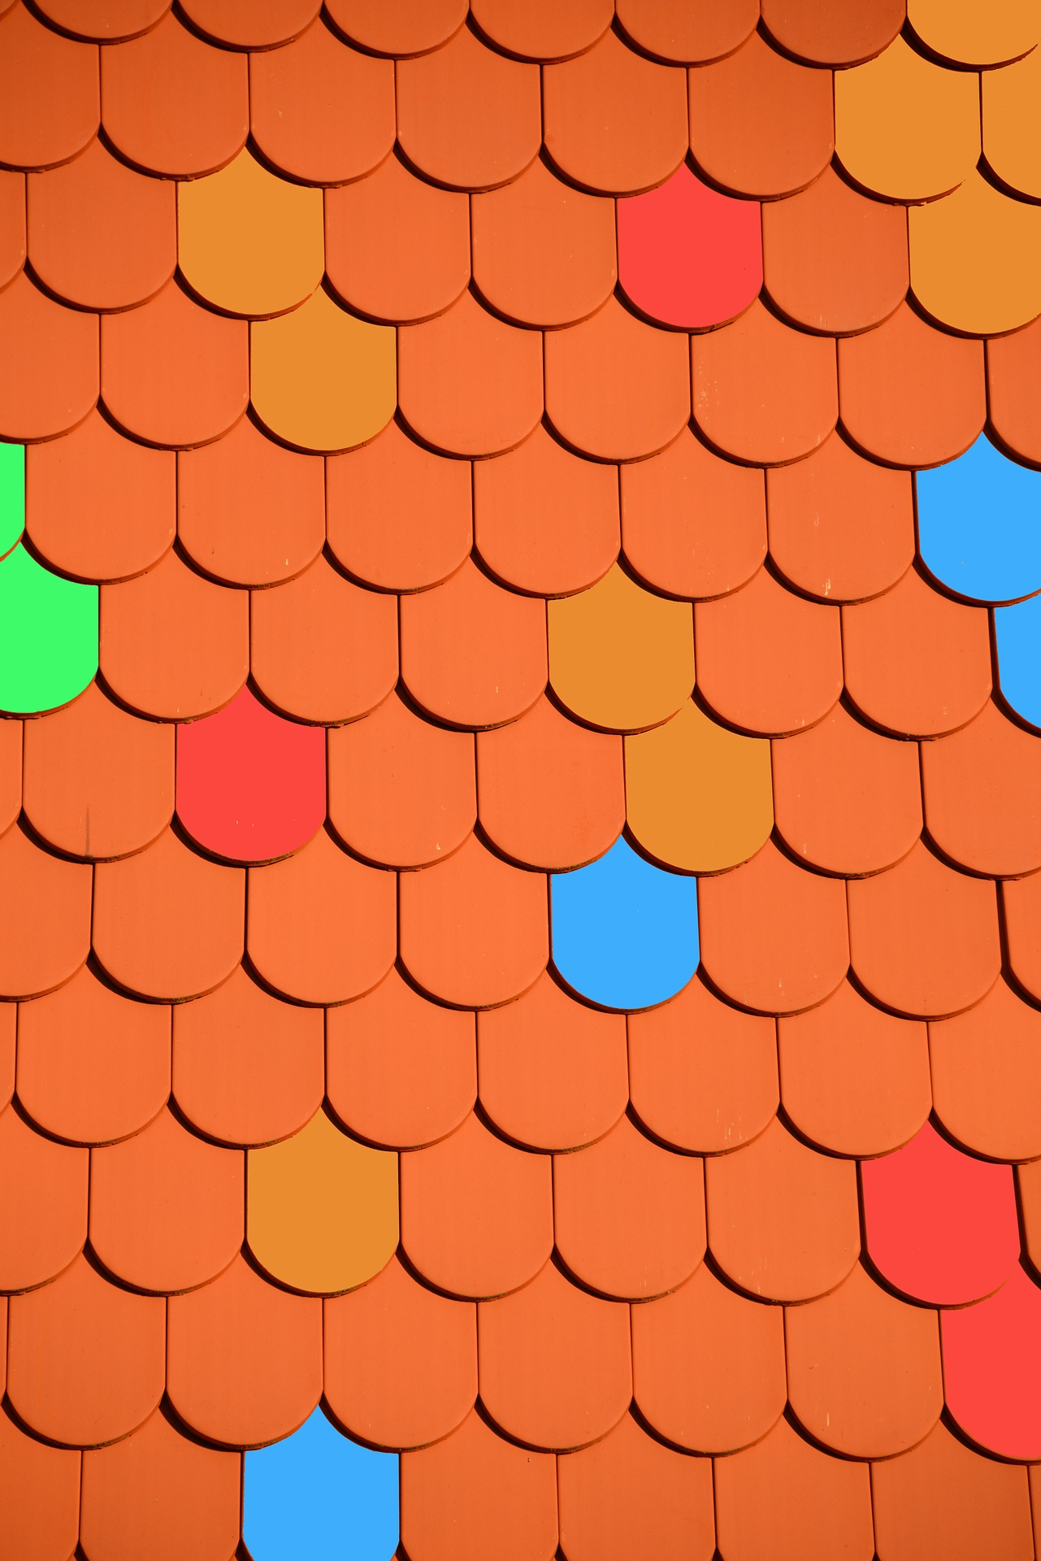
© Copyright Kapow! 2017

Slide 8
© Copyright Kapow! 2017

Slide 9
© Copyright Kapow! 2017

