Slide 1
History of the Blues
© Copyright Kapow! 2017

Slide 2
Dynamics (volume)
Instruments
What are the lyrics
about?
Blues music
Tempo (speed)
Emotions
© Copyright Kapow! 2017

Slide 3
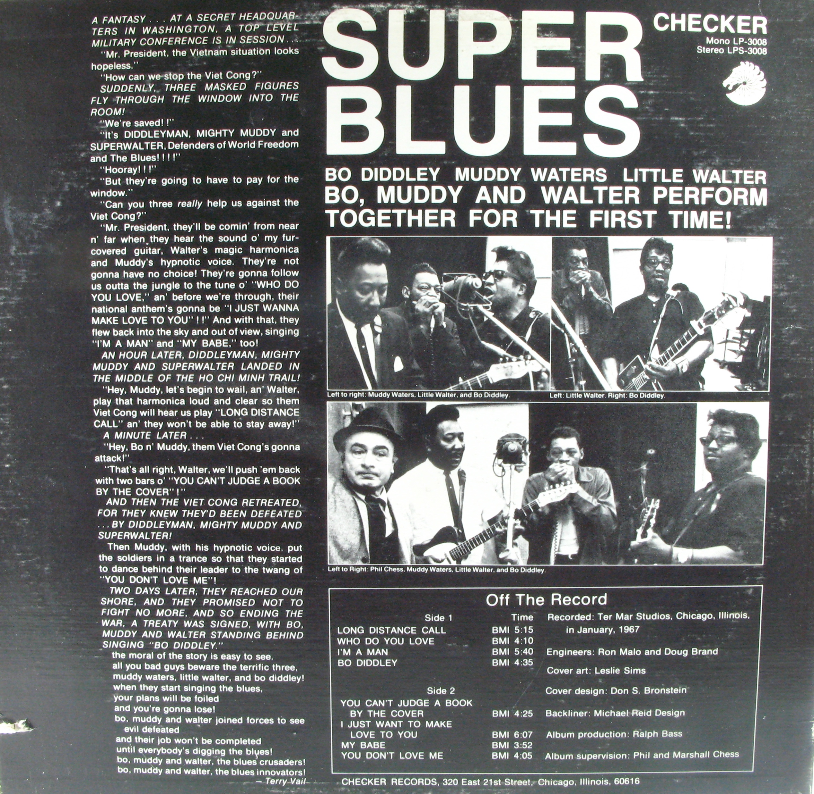
What is blues music?
Blues music is about sadness, hardship and tough times, about lost love and heartache or overcoming hard luck.
It’s about saying how you feel, getting rid of any frustration and having fun
© Copyright Kapow! 2017

Slide 4
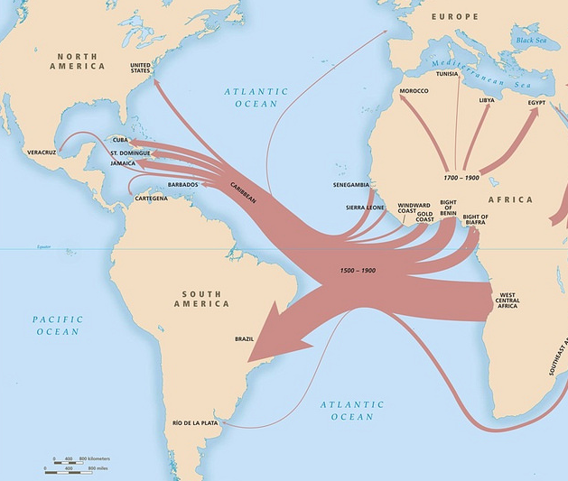
Where does it come from?
The blues originated in America.
It was started by black African slaves, ex-slaves and descendants of slaves singing about how their life was in the years since they were taken to the Americas.
It is often thought that the blues is influenced by African tribal chants and work songs.
It has influenced many different styles of music – most notably jazz and rock and roll.
© Copyright howard_morland
© Copyright Kapow! 2017

Slide 5
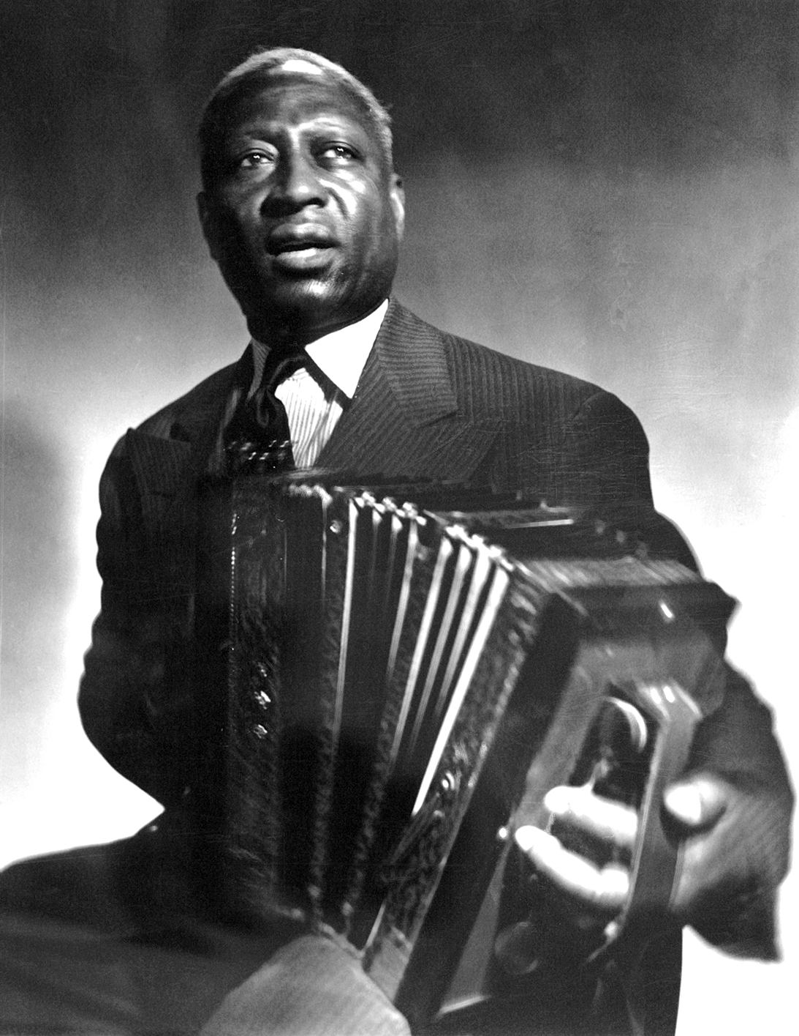
What is the basis for blues music?
Blues music tends to use something called the 12 bar blues.
This is 12 bars (4 counts) of chords repeated over and over.
It usually only uses three chords.
It also uses improvisation – improvisation is where you make something up as you go along (this is how it all began!)
Huddie William Ledbetter “Leadbelly”
© Copyright Kapow! 2017

Slide 6
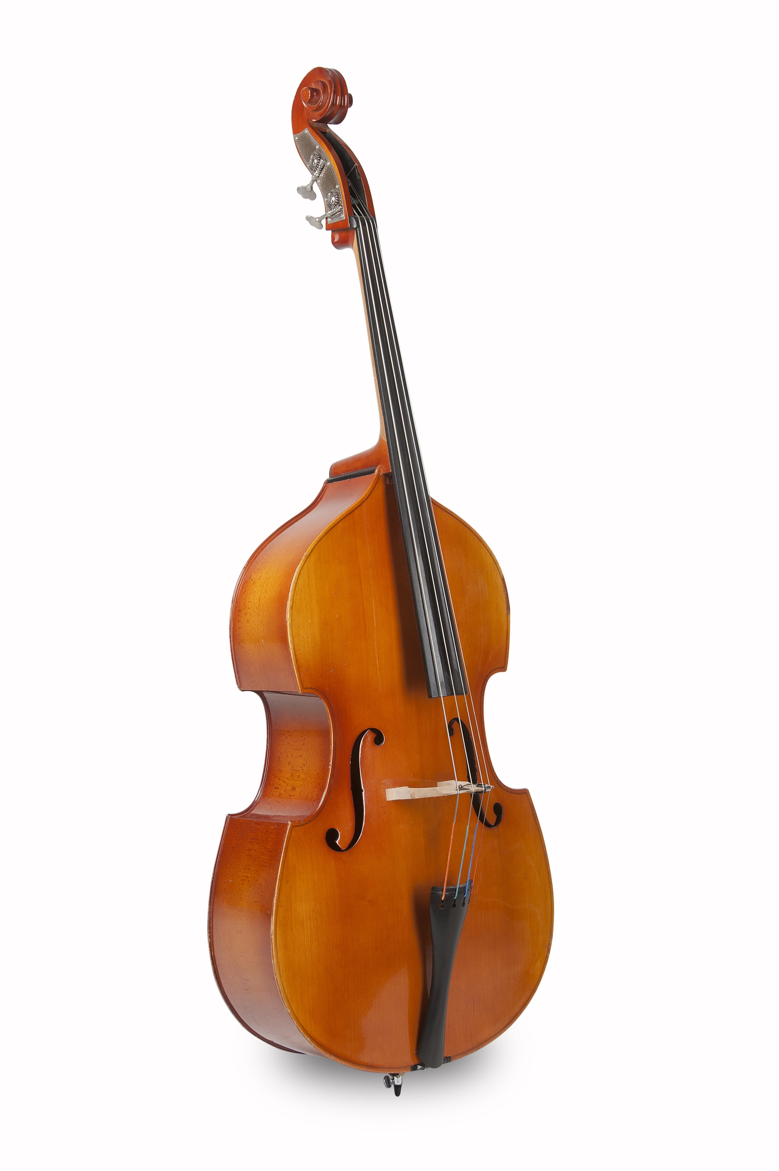
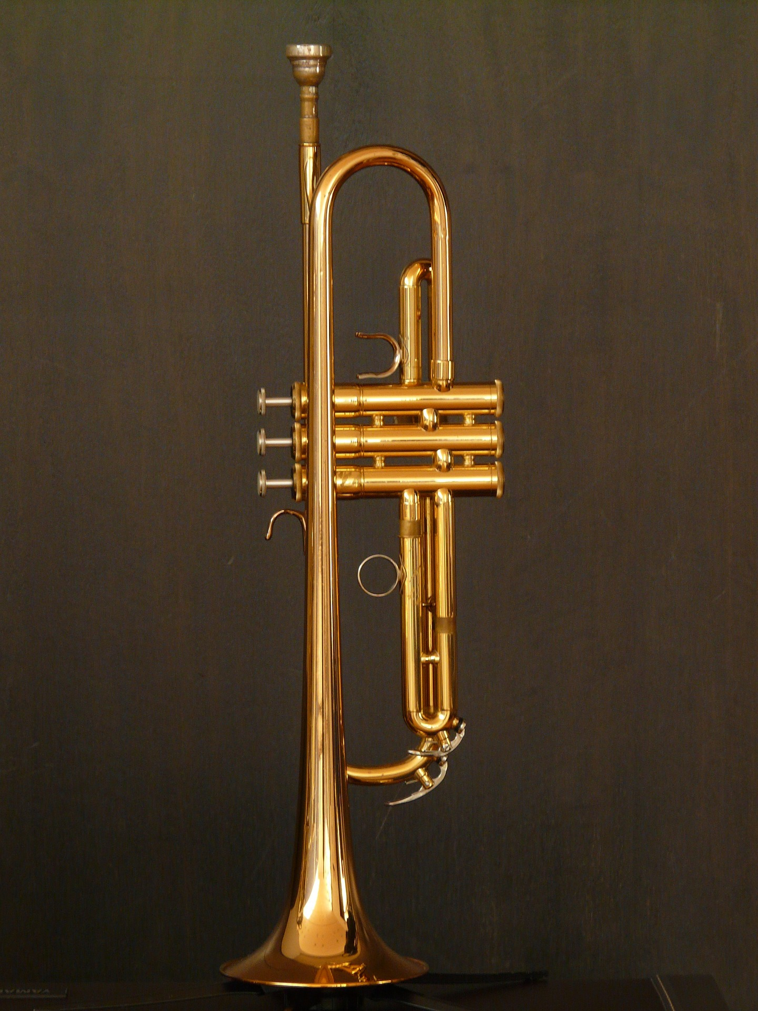
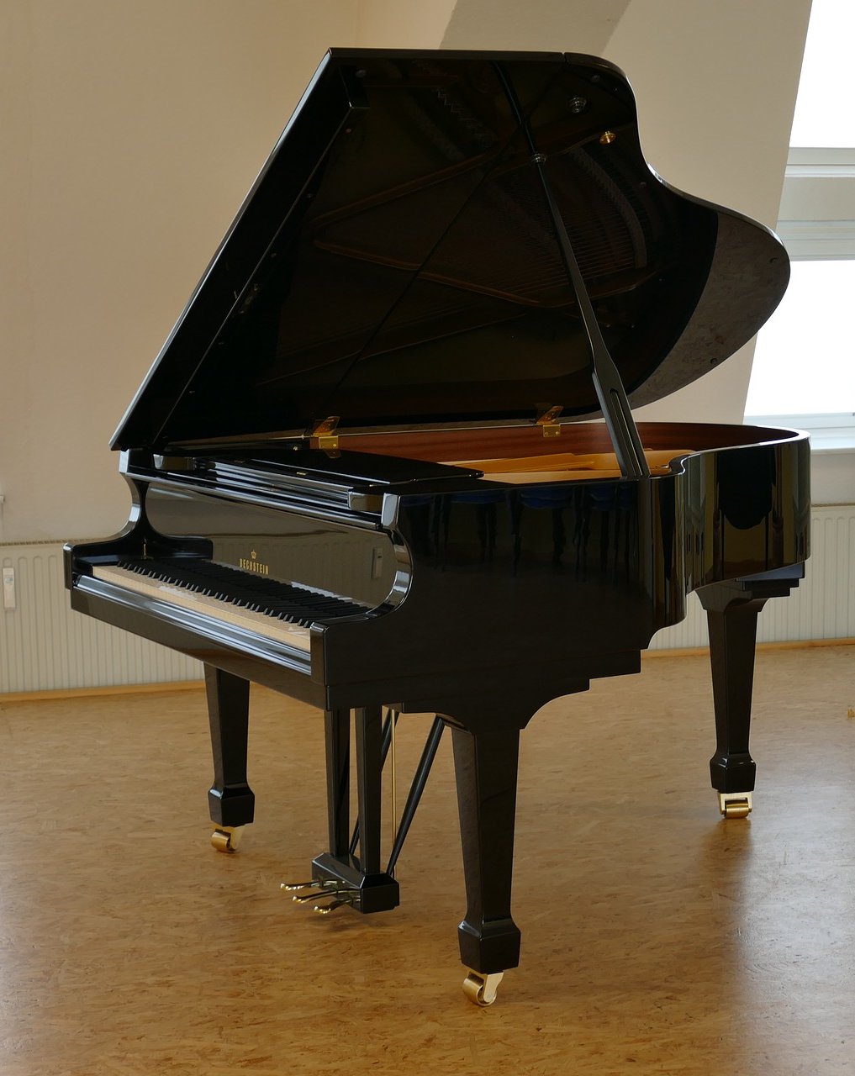
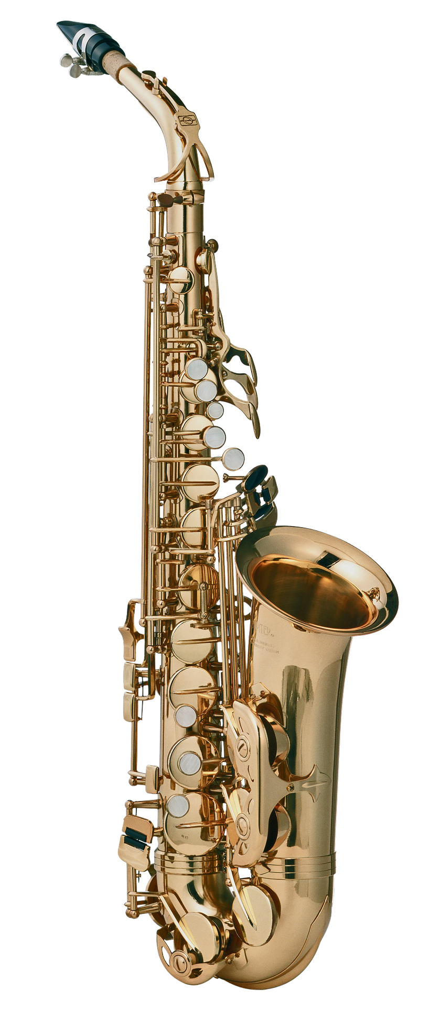
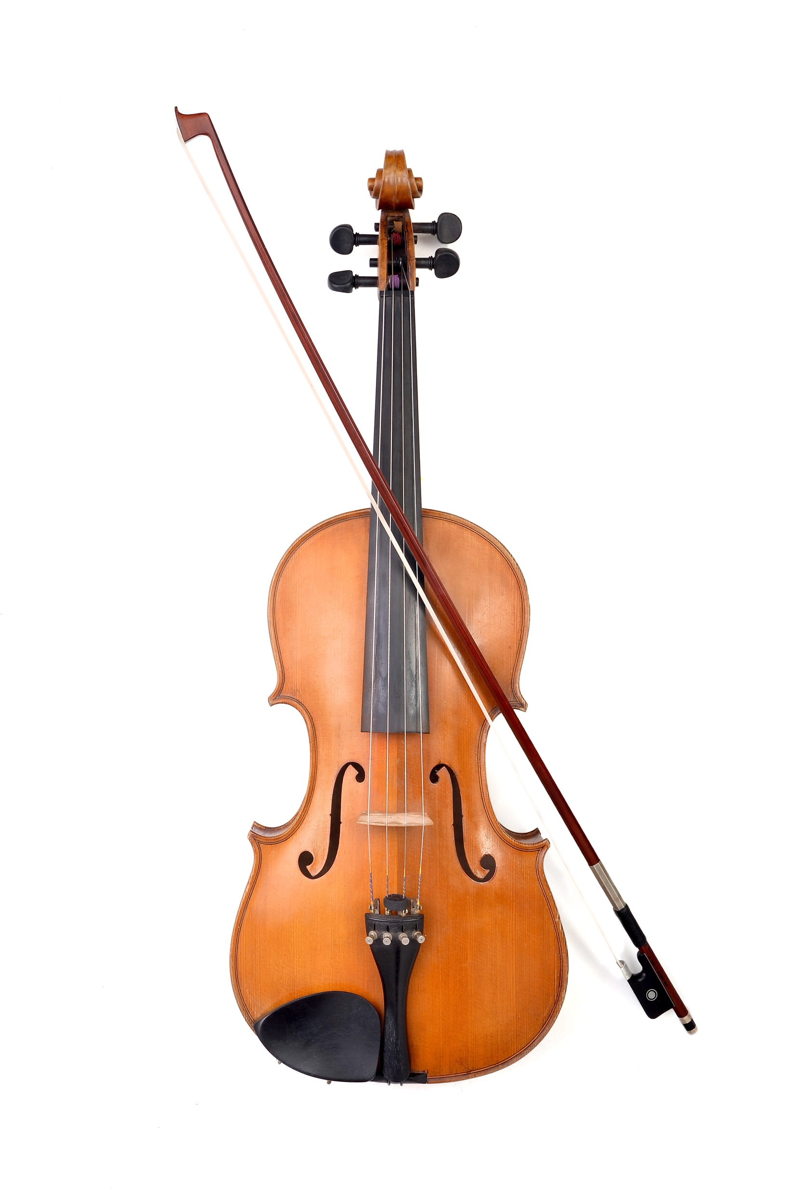
Guess the odd one out
© Copyright Shutterstock/the palms
© Copyright Shutterstock/Florin Burlan
© Copyright Kapow! 2017

Slide 7
What instruments does it use?
Listen to the blues music – what instruments can you hear?
Drums
Bass – usually acoustic
Piano or keyboard
Trumpet / trombone
Clarinet
Saxophone
Guitar
Singing
© Copyright Kapow! 2017

Slide 8
The Moanin' Lisa Blues.
I've got a bratty brother, Who bugs me every day. This morning my old mother, Gave my last cupcake away. My dad he acts like, Like he belongs in the zoo. I'm the saddest kid, The saddest kid in Grade number two. I wish I had a pony, I wish I were eighteen, I wish I had a dime For every kid who treats me mean. They tease me 'cause I'm diff'rent, Little diff'rent from the rest, oh yes. Well, I'm down so low, If I cheered up, I'd still be depressed.
The saxophone's my best friend, I play all over town. But when I practice in my room, I hear Homer: Lisa! Keep it down! Lisa: Although I'm only eight years old, I've really paid my dues, it's true. That's why I've got a case of, A case of the Moanin' Lisa Blues. (Guitar solo) I wonder how I got here, I wonder what I'll be. The saddest little twig On this crazy family tree. I feel like I'm a loser, With nothing left to lose. That's why I've got a case of, A case of the Moanin' Lisa Blues. Oh there's just no postponing, A case of the Moanin' Lisa Blues.
© Copyright Kapow! 2017

